Slide 1
Quantum Computer

Slide 2
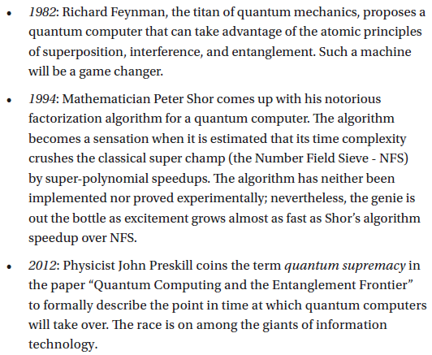
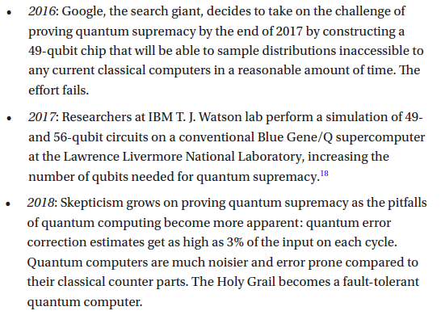
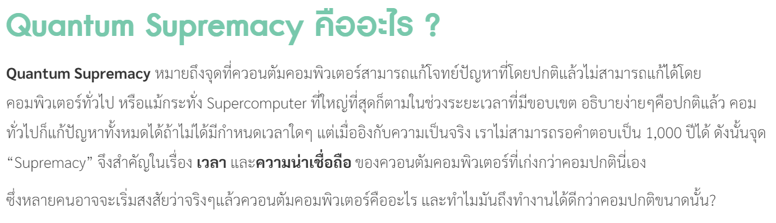

Slide 3
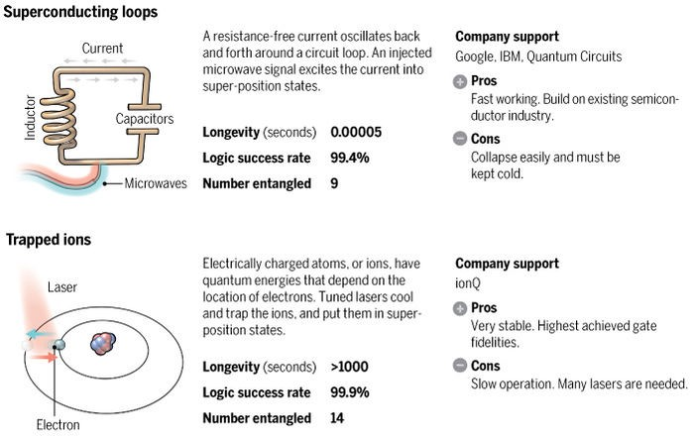
Types of Qubits (Jan 23, 2018)
https://hackernoon.com/a-brief-introduction-to-quantum-computing-d21e578cb7ed

Slide 4
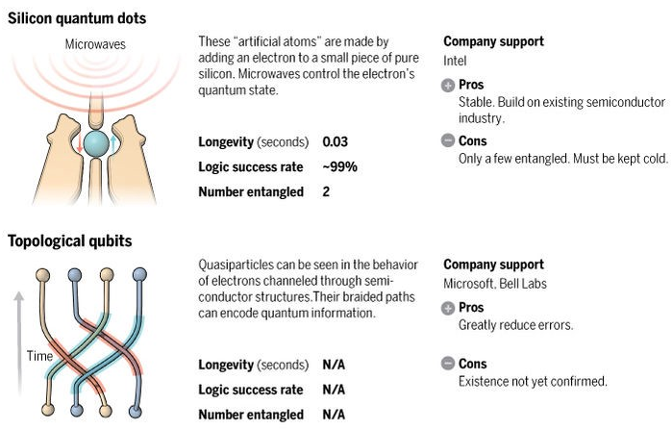
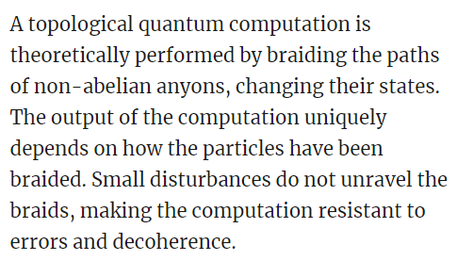
Types of Qubits
ดูคำอธิบายใน TED Ed
https://www.youtube.com/watch?v=GJHhnr9R_ZM https://www.quantamagazine.org/construction-begins-of-topological-qubit-route-to-quantum-computer-20140515/

Slide 5
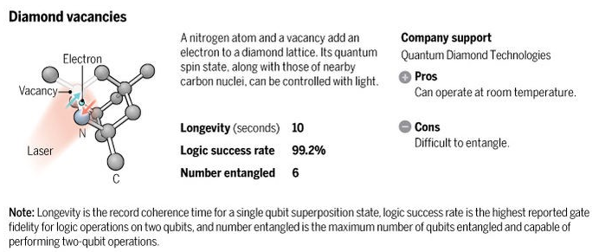
Types of Qubits

Slide 6
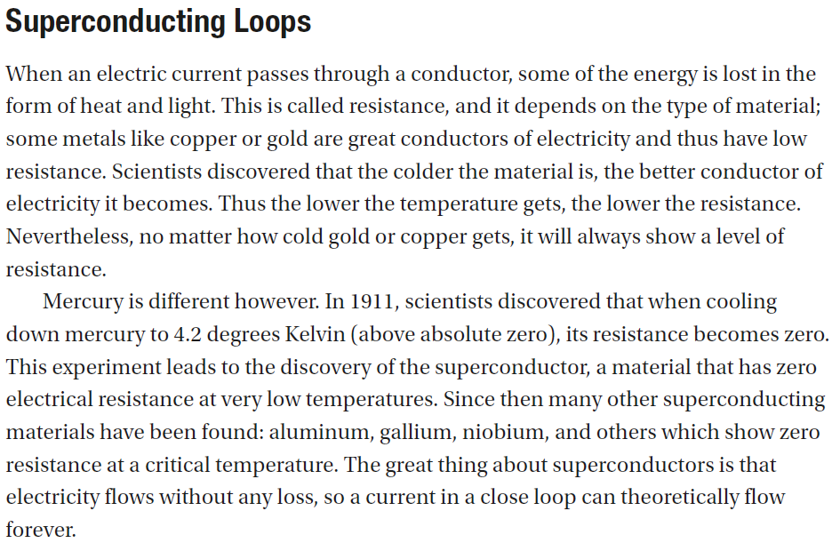

Slide 7
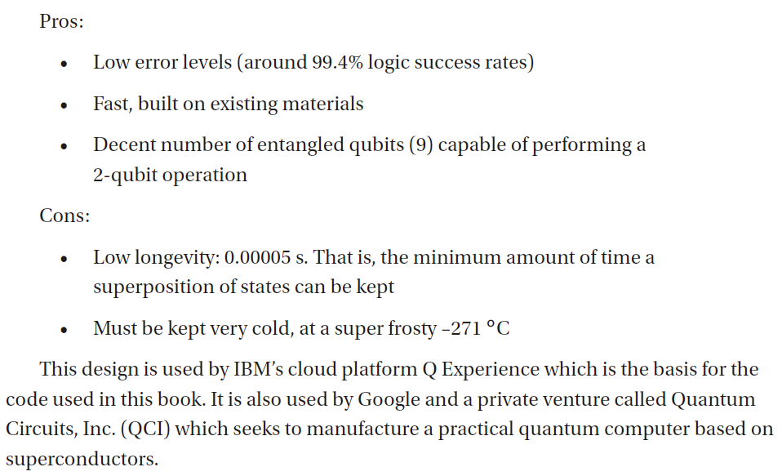
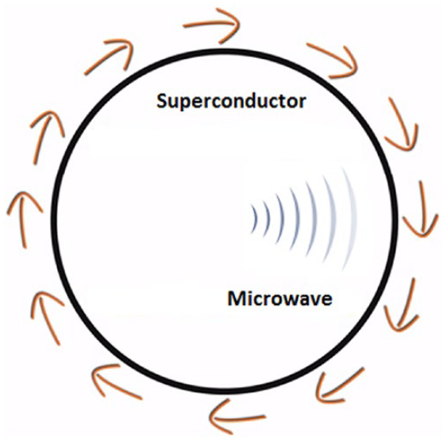

Slide 8
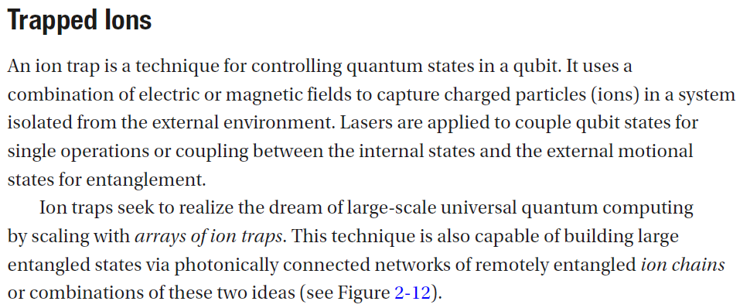
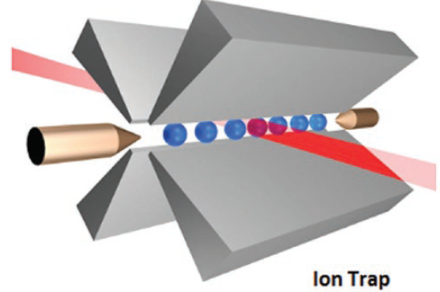
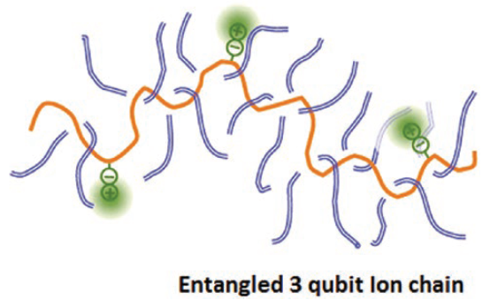

Slide 9
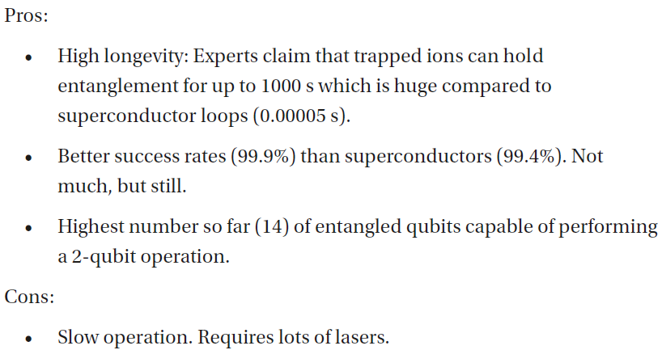

Slide 10
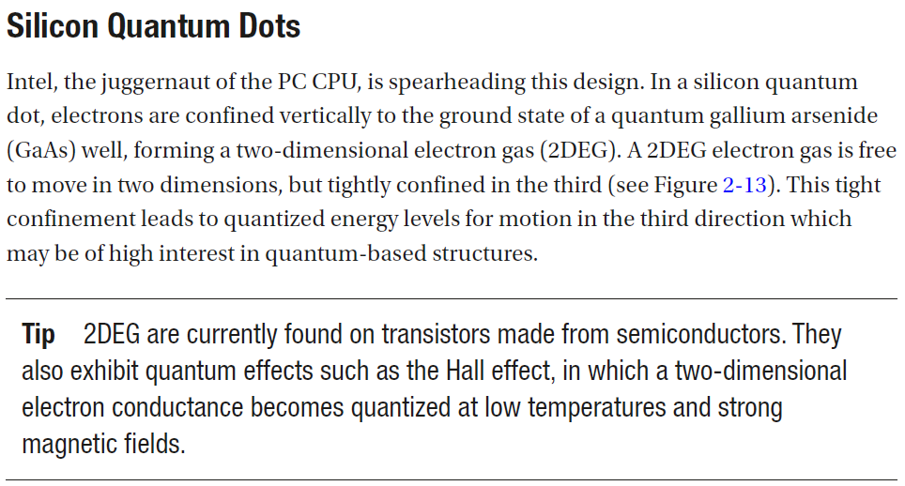

Slide 11
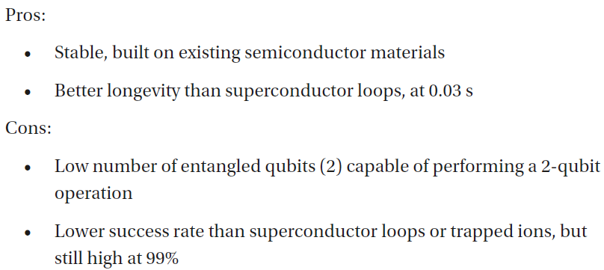
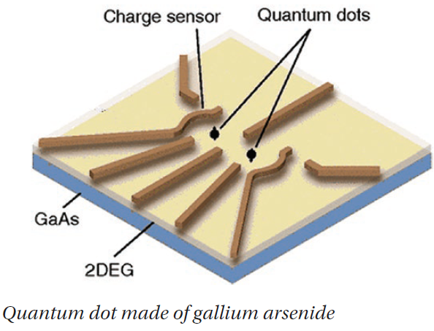

Slide 12
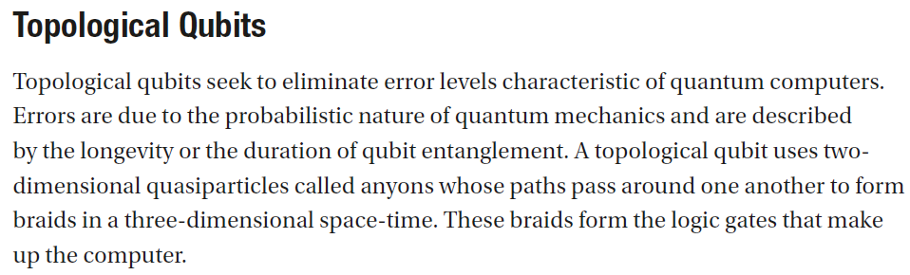

Slide 13
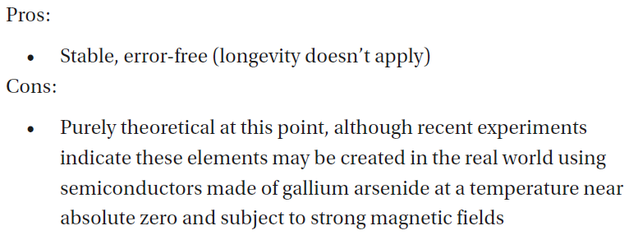
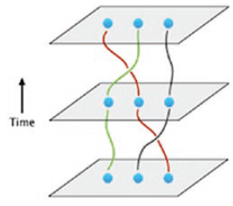

Slide 14
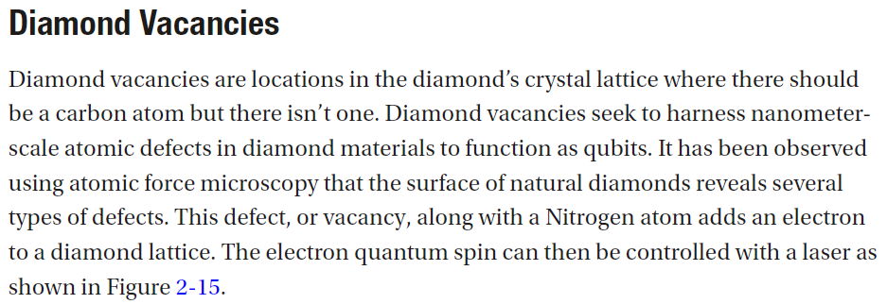
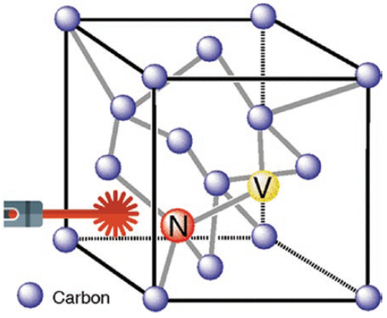

Slide 15
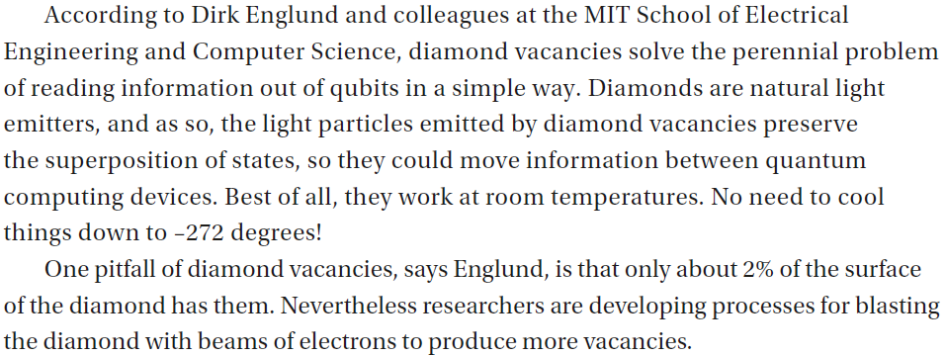

Slide 16
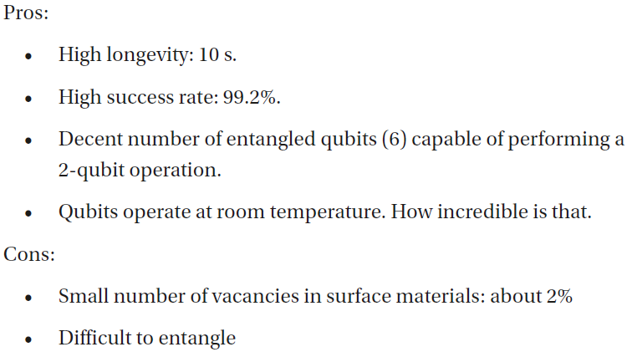

Slide 17
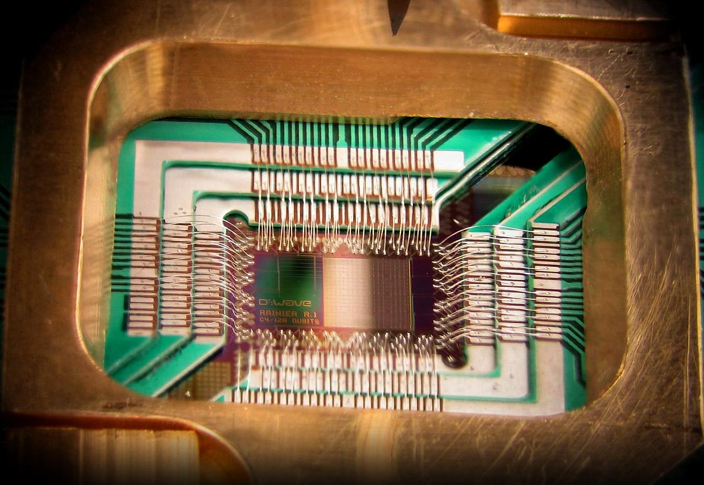
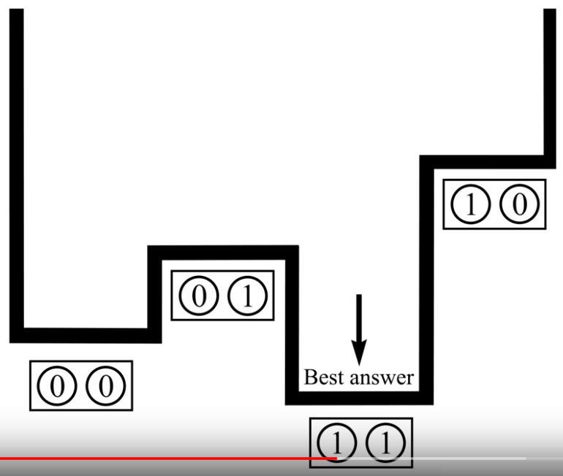
Adiabatic Quantum Computers
Adiabatic Process https://www.youtube.com/watch?v=hKidaA4S2GQ
What is Quantum Annealing https://www.youtube.com/watch?v=zvfkXjzzYOo
How The Quantum Annealing Process Works https://www.youtube.com/watch?v=UV_RlCAc5Zs
Hamiltonian and Eigenspectrum https://youtube.com/watch?v=tnikftltqE0
Measuring Quantum Physics https://www.youtube.com/watch?v=kq9VqR0ZGNc

Slide 18
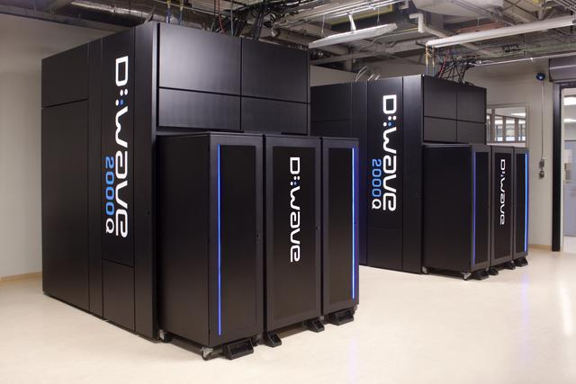
D-Wave

Slide 19
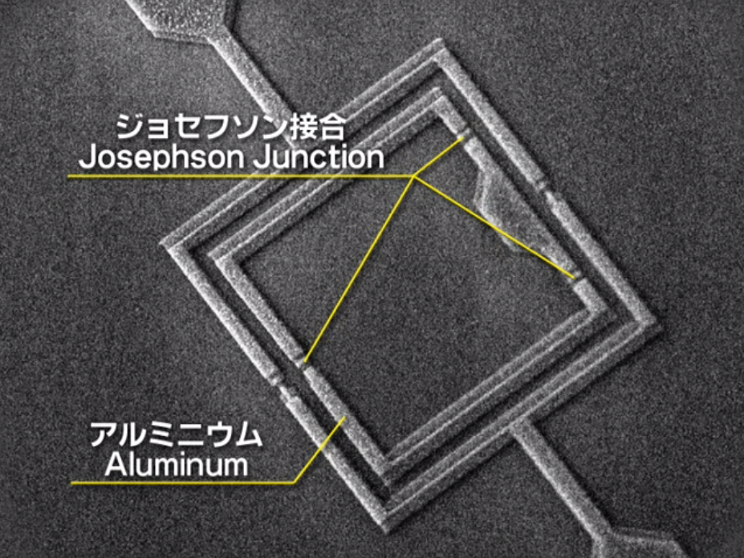
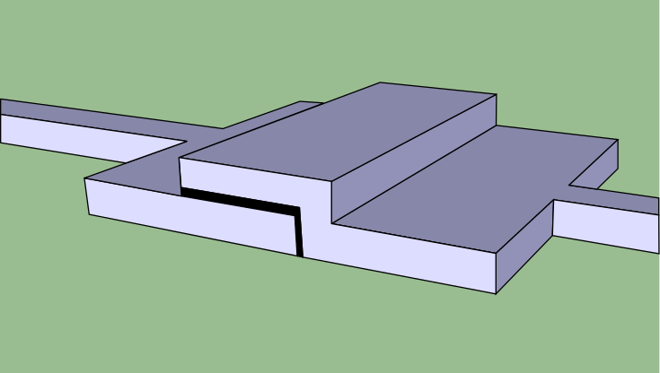
Superconducting Qubits
Josephson junction
Single-qubit gates
The axis of rotation is set by quadrature amplitude modulation of the microwave pulse, while the pulse length determines the angle of rotation.
https://www.youtube.com/watch?v=daQJMwvxC_U

Slide 20
Obstacles
Scalable physically to increase the number of qubits
Qubits that can be initialized to arbitrary values
Quantum gates that are faster than decoherence time
Universal gate set
Qubits that can be read easily
https://en.wikipedia.org/wiki/Quantum_computing

Slide 21
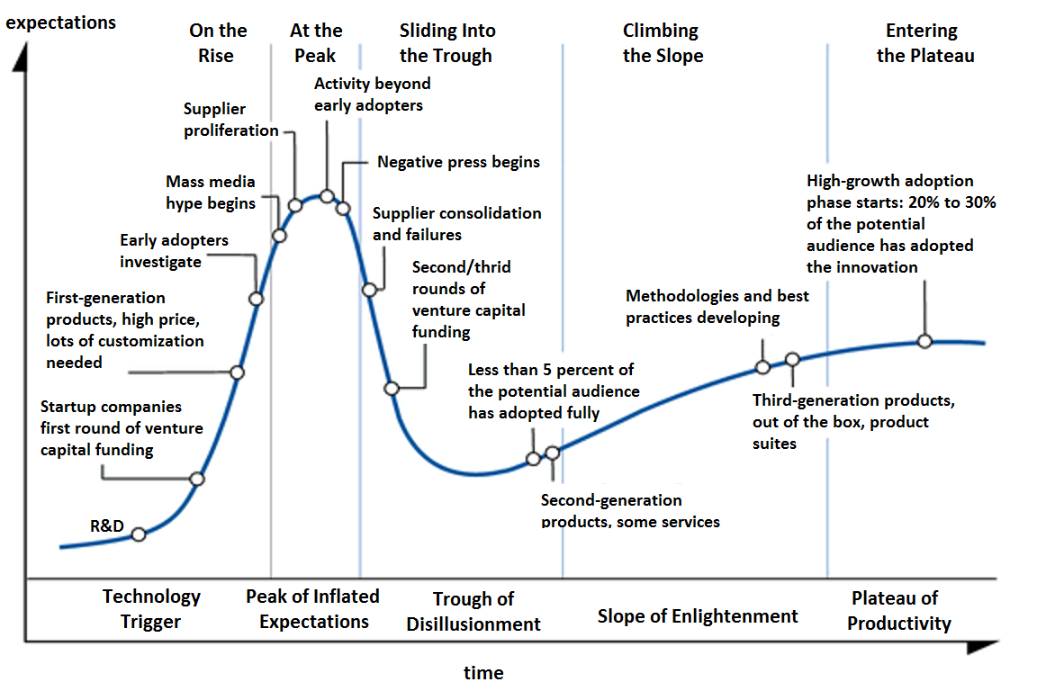
Quantum Computing Companies
IBM 1990
D-Wave 1999
Microsoft 2005
Hitachi 2012
Google 2013
Intel 2015
Baidu 2018
Gartner Hype Cycle
https://en.wikipedia.org/wiki/List_of_companies_involved_in_quantum_computing_or_communication

Slide 22
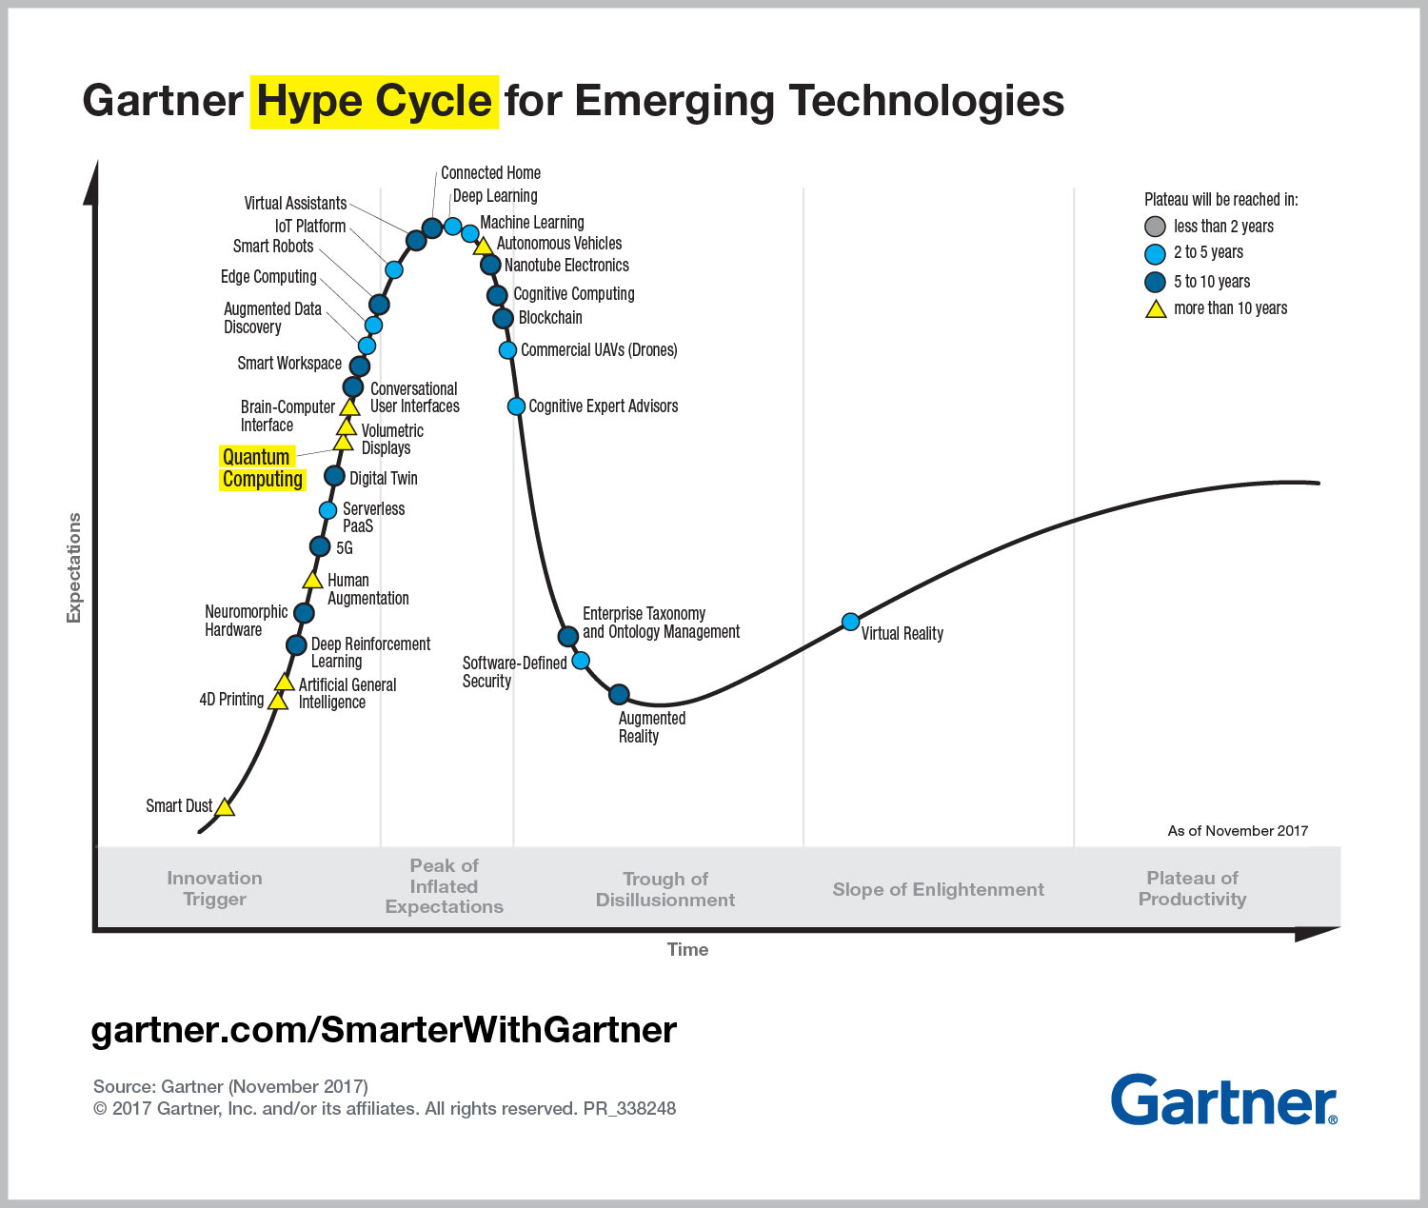

Slide 23
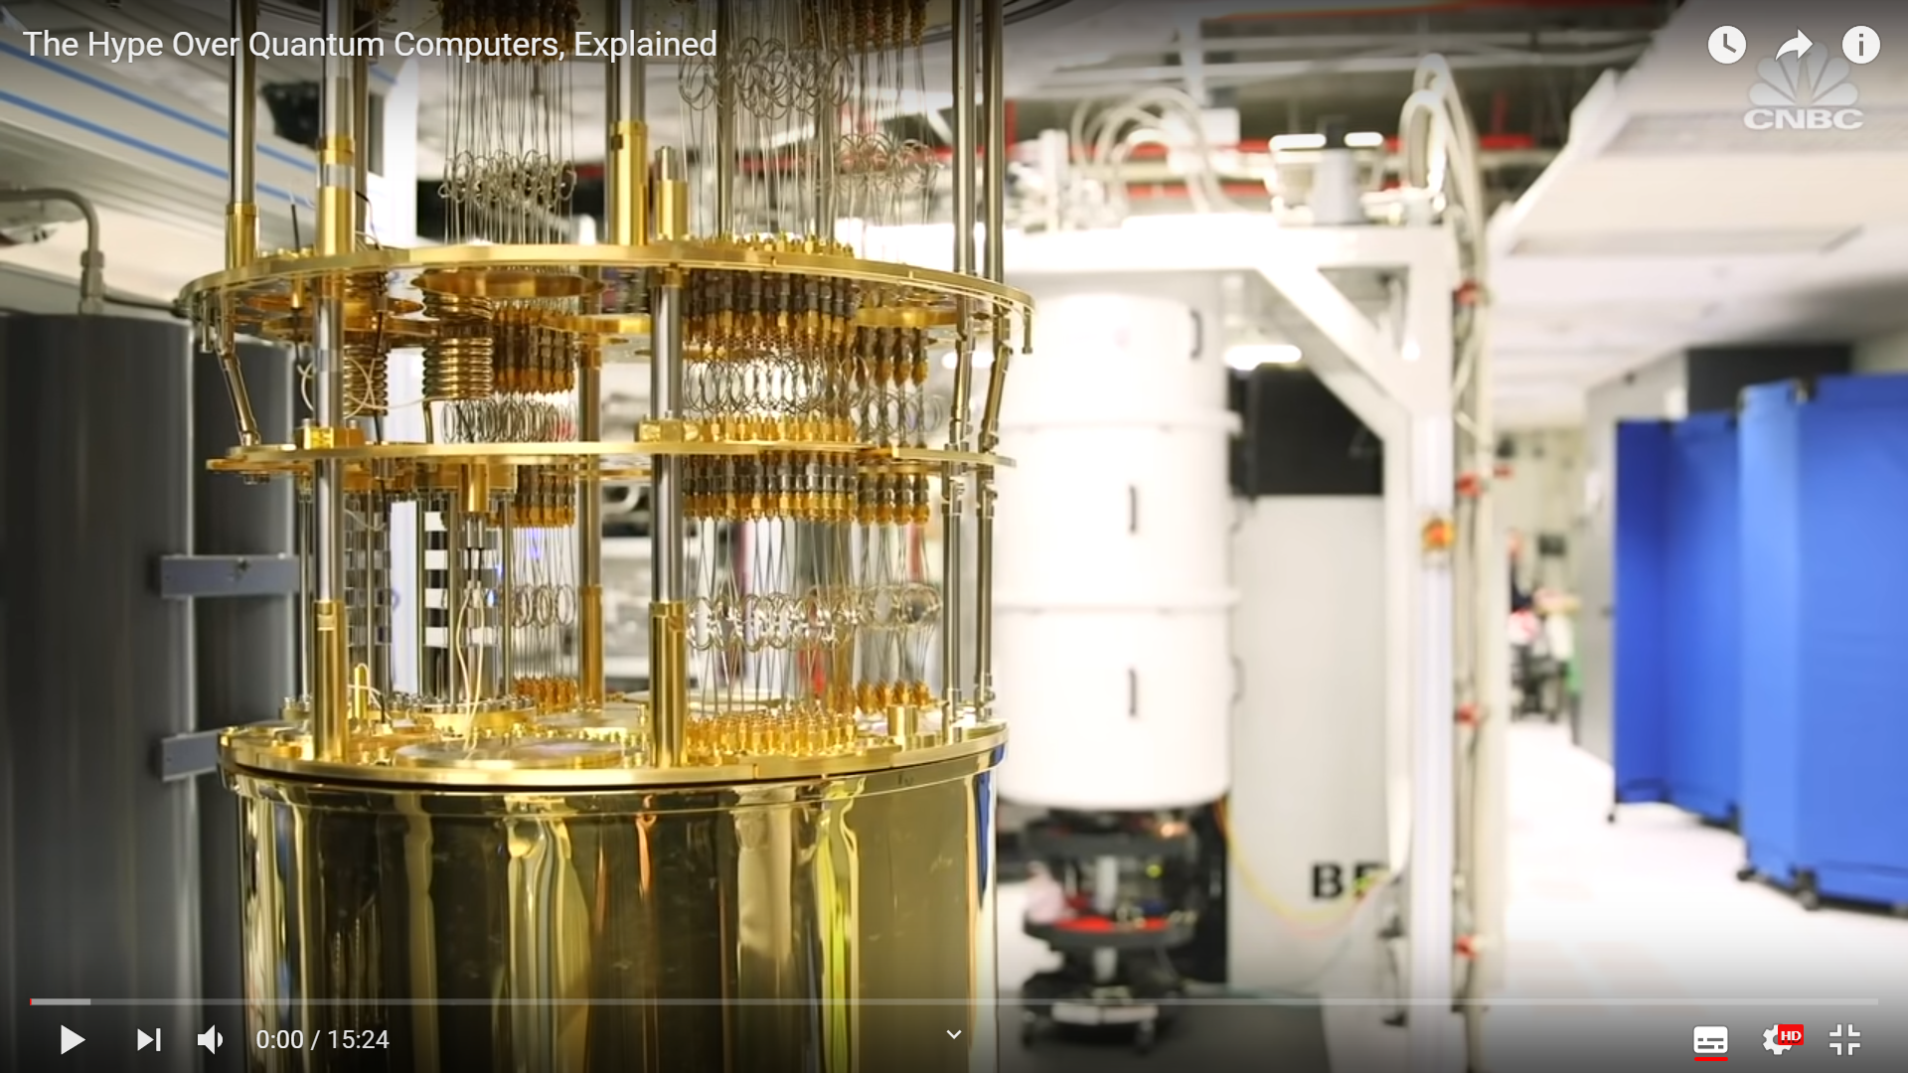
https://www.youtube.com/watch?v=u1XXjWr5frE

Slide 24
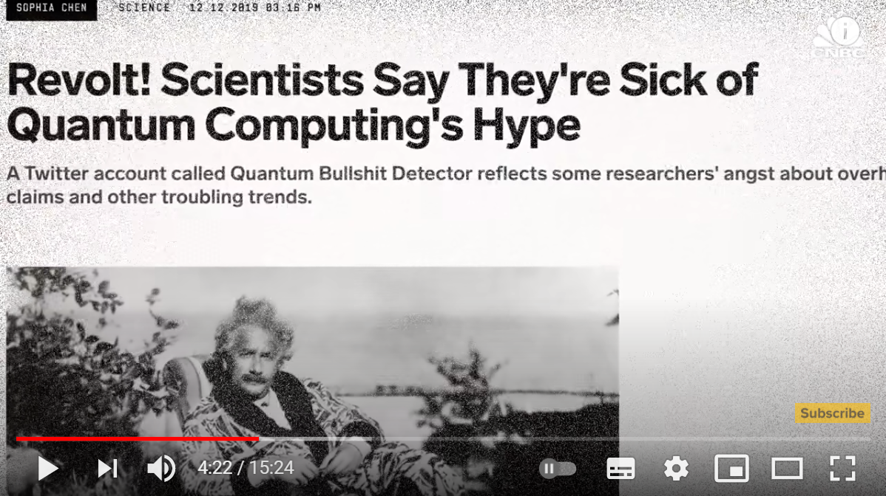

Slide 25
