Slide 1
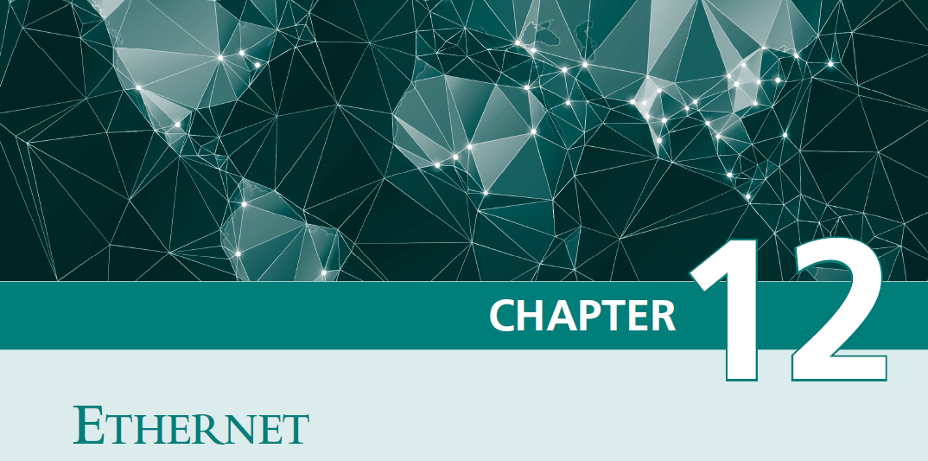

Slide 2
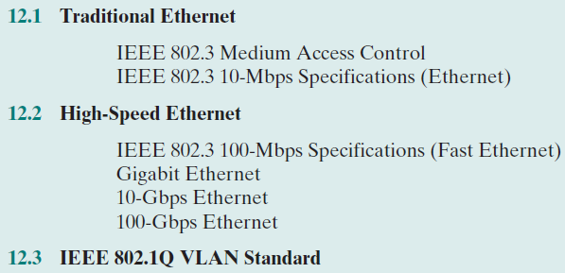

Slide 3
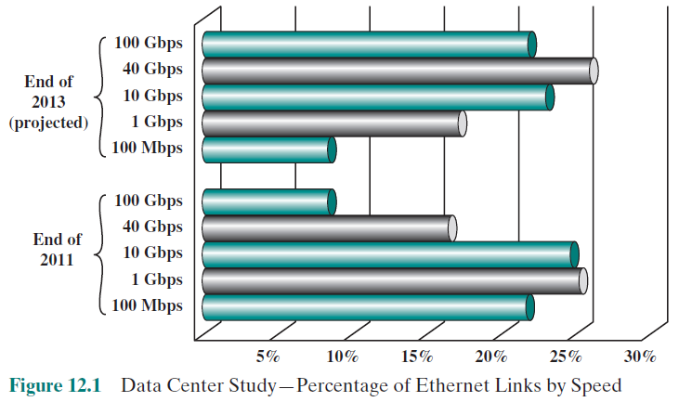
Data Rate

Slide 4
ALOHA
ALOHA = a protocol for packet radio networks (เอาไปใช้กับ shared medium ได้ด้วย)
A station may transmit a frame any time.
The station then listens for an amount of time equal to the maximum possible round-trip propagation delay on the network (twice the time it takes to send a frame between the two most widely separated stations) plus a small fixed time increment.
If the station hears an acknowledgment during that time, fine; otherwise, it resends the frame. If the station fails to receive an acknowledgment after repeated transmissions, it gives up.
A receiving station determines the correctness of an incoming frame by examining a frame check sequence field. If the frame is valid and if the destination address in the frame header matches the receiver’s address, the station immediately sends an acknowledgment.
The frame may be invalid due to noise on the channel or because another station transmitted a frame at about the same time. In the latter case, the two frames may interfere with each other at the receiver so that neither gets through; this is known as a collision. If a received frame is determined to be invalid, the receiving station simply ignores the frame.
Because the number of collisions rises rapidly with increased load, the maximum utilization of the channel is only about 18%.

Slide 5
เริ่มส่งข้อมูลได้เฉพาะตรงรอยต่อของ frame
Slotted ALOHA
Slot 1
Slot 2
Slot 3
Slot 4
1 time slot = 1 frame
To improve efficiency, a modification of ALOHA, known as slotted ALOHA, was developed. In this scheme, time on the channel is organized into uniform slots whose size equals the frame transmission time. Some central clock or other technique is needed to synchronize all stations. Transmission is permitted to begin only at a slot boundary. Thus, frames that do overlap will do so totally. This increases the maximum utilization of the system to about 37%.
Both ALOHA and slotted ALOHA exhibit poor utilization. Both fail to take advantage of one of the key properties of both packet radio networks and LANs, which is that propagation delay between stations may be very small compared to frame transmission time. Consider the following observations. If the station-to-station propagation time is large compared to the frame transmission time, then, after a station launches a frame, it will be a long time before other stations know about it. During that time, one of the other stations may transmit a frame; the two frames may interfere with each other and neither gets through. Indeed, if the distances are great enough, many stations may begin transmitting, one after the other, and none of their frames get through unscathed.
Suppose, however, that the propagation time is small compared to frame transmission time. In that case, when a
station launches a frame, all the other stations know it almost immediately. So, if they had any sense, they would not try transmitting until the first station was done. Collisions would be rare because they would occur only when two stations began to transmit almost simultaneously.
ALOHA ไม่ได้ใช้ประโยชน์เมื่อ propagation time มีค่าน้อย และ frame ยาว (เช่น การคุยกันในห้อง) ดังนั้นจึงต้องมี CSMA ในหน้าถัดไป

Slide 6
Carrier Sense Multiple Access (CSMA)
With CSMA, a station wishing to transmit first listens to the medium to determine if another transmission is in progress (carrier sense). If the medium is in use, the station must wait. If the medium is idle, the station may transmit. It may happen that two or more stations attempt to transmit at about the same time. If this happens, there will be a collision; the data from both transmissions will be garbled and not received successfully. To account for this, a station waits a reasonable amount of time after transmitting for an acknowledgment, taking
into account the maximum round-trip propagation delay and the fact that the acknowledging station must also contend for the channel to respond. If there is no acknowledgment, the station assumes that a collision has occurred and retransmits.
One can see how this strategy would be effective for networks in which the average frame transmission time is much longer than the propagation time. Collisions can occur only when more than one user begins transmitting within a short time interval (the period of the propagation delay). If a station begins to transmit a frame, and there are no collisions during the time it takes for the leading edge of the packet to propagate to the farthest station, then there will be no collision for this frame because all other stations are now aware of the transmission.

Slide 7
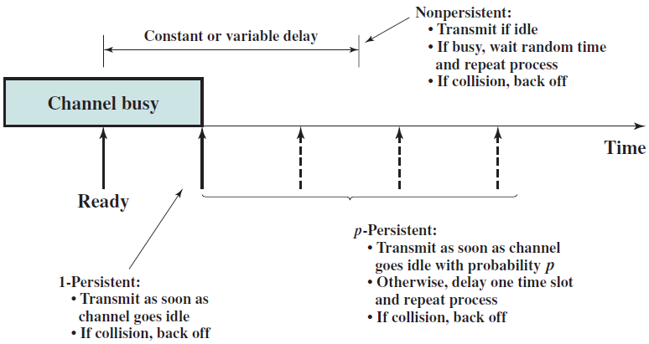
CSMA if the medium is busy
Non-persistent algorithm
1-persistent algorithm
p-persistent algorithm
ทำ CD หน้าถัดไป
ทำ CD หน้าถัดไป
ทำ CD หน้าถัดไป
n × p ควรจะน้อยกว่า 1 เมื่อ n คือจำนวน station !!!
แต่ถ้าน้อยเกินไปก็รอนานกว่าจะได้ส่ง

Slide 8
CSMA-CD (with Collision Detection)
CSMA, although more efficient than ALOHA or slotted ALOHA, still has one glaring inefficiency. When two frames collide, the medium remains unusable for the duration of transmission of both damaged frames. For long frames, compared to propagation time, the amount of wasted capacity can be considerable. This waste can be reduced if a station continues to listen to the medium while transmitting. This leads to the following rules for CSMA/CD:

Slide 9
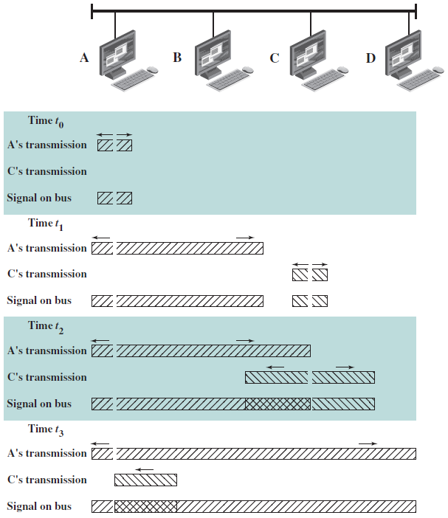
พอ C รู้ว่าเกิด collision แล้ว C ก็หยุดส่งทันที
The amount of time that it takes to detect a collision is no greater than twice the end-to-end propagation delay.
พอ A รู้ว่าเกิด collision แล้ว A ก็หยุดส่งทันที

Slide 10
Binary Exponential Backoff
CSMA-CD ใช้ 1-persistent algorithm โดยหวังว่า
1. เวลาที่เสียไปจาก collision ไม่มาก frame ยาวกว่า propagation time มาก
2. รอบหน้าจะไม่ collision อีก ต้องพึ่ง Binary Exponential Backoff
IEEE 802.3 and Ethernet use a technique known as binary exponential backoff. A station will attempt to transmit repeatedly in the face of repeated collisions. For the first 10 retransmission attempts, the mean value of the random delay is doubled. This mean value then remains the same for 6 additional attempts. After 16 unsuccessful attempts, the station gives up and reports an error.
The beauty of the 1-persistent algorithm with binary exponential backoff is that it is efficient over a wide range of loads. At low loads, 1-persistence guarantees that a station can seize the channel as soon as it goes idle, in contrast to the non- and p-persistent schemes. At high loads, it is at least as stable as the other techniques. However, one unfortunate effect of the backoff algorithm is that it has a last-in first-out effect; stations with no or few collisions will have a chance to transmit before stations that have waited longer.
ใน LAN วงหนึ่ง (Ethernet) มีคอมพิวเตอร์มากๆ เป็นหมื่นเป็นแสนเครื่องไม่ได้ !!!

Slide 11
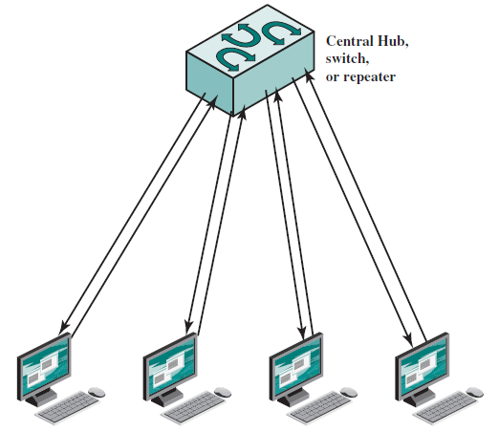
Cable Length (limited by CD)
For baseband bus, a collision should produce substantially higher voltage swings than those produced by a single transmitter. Accordingly, the IEEE standard dictates that the transmitter will detect a collision if the signal on the cable at the transmitter tap point exceeds the maximum that could be produced by the transmitter alone. Because a transmitted signal attenuates as it propagates, there is a potential problem: If two stations far apart are transmitting, each station will receive a greatly attenuated signal from the other. The signal strength could be so small that when it is added to the transmitted signal at the transmitter tap point, the combined signal does not exceed the CD threshold. For this reason, among others, the IEEE standard restricts the maximum length of coaxial cable to 500 m for 10BASE5 and 200 m for 10BASE2.
Collision !!!
ถึงใช้ Switch หรือ Hub ก็เกิด collision ได้ เช่น 1. สายมันเป็น half duplex ข้อมูลวิ่งสวนกันไม่ได้
2. ถ้าผู้ส่งมากกว่าสองคนส่งไปยังผู้รับคนเดียวกันพร้อมกัน

Slide 12
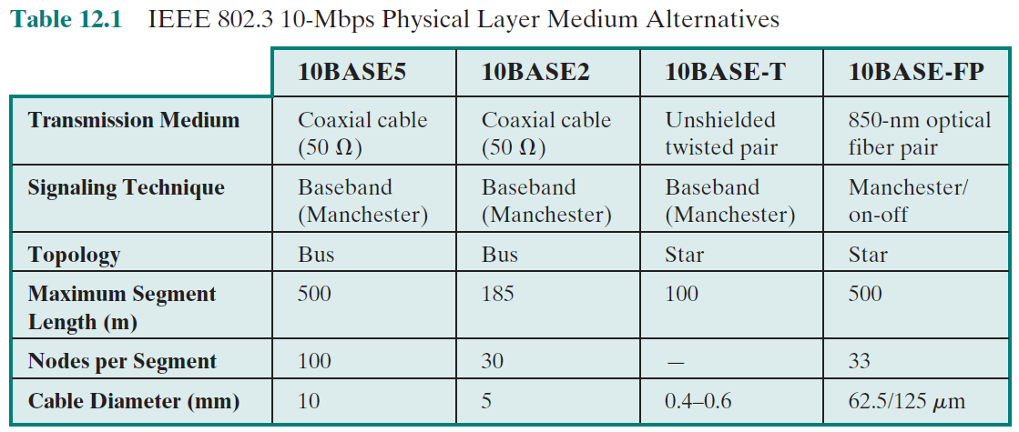
ถ้าจะไปให้ไกลกว่านี้ก็ต้องใช้ repeater ช่วย แต่ไปไกลมากก็ทำให้ propagation time มาก ไม่ดีกับ CSMA/CD (ลองยกตัวอย่าง/สถานการณ์) โปรโตคอลนี้จึงใช้ได้กับ local area network เท่านั้น แต่ในกรณีของ full-duplex switch ที่ไม่มี collision จะลากไปไกลเท่าไหร่ก็คงได้ ใช้ repeater ช่วยเอา แต่จะใช้ CSMA/CD ทั้งเมืองคงไม่ได้ เพราะไม่มี switch ที่รองรับ station จำนวนมากเป็นพันๆ หมื่นๆ เครื่อง

Slide 13
High-Speed Ethernet

Slide 14
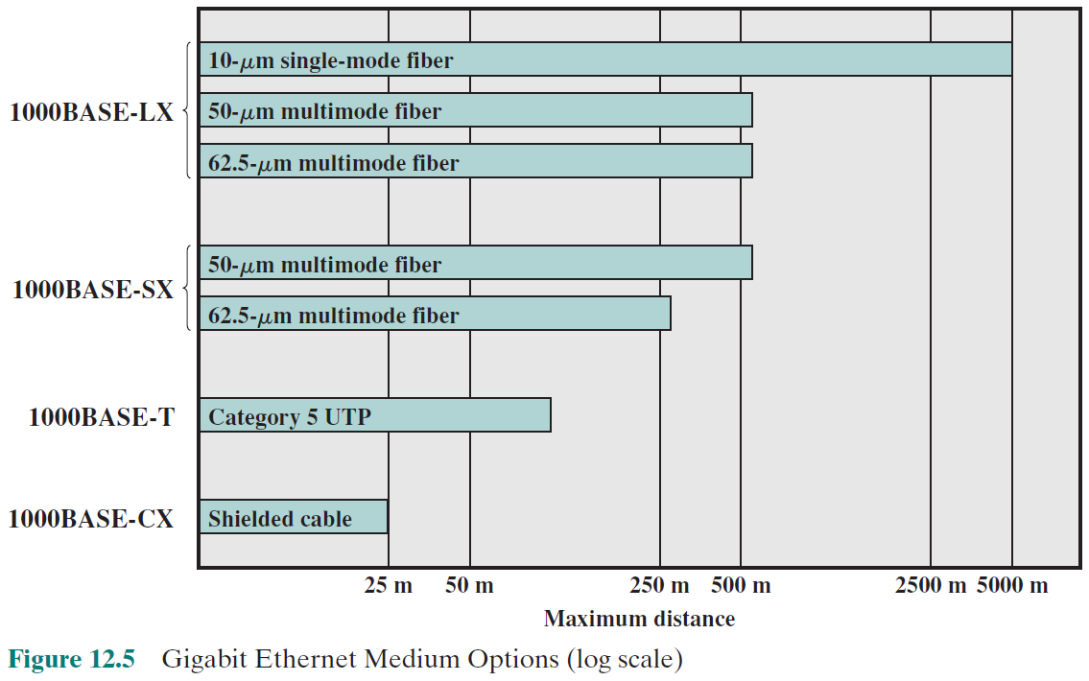

Slide 15
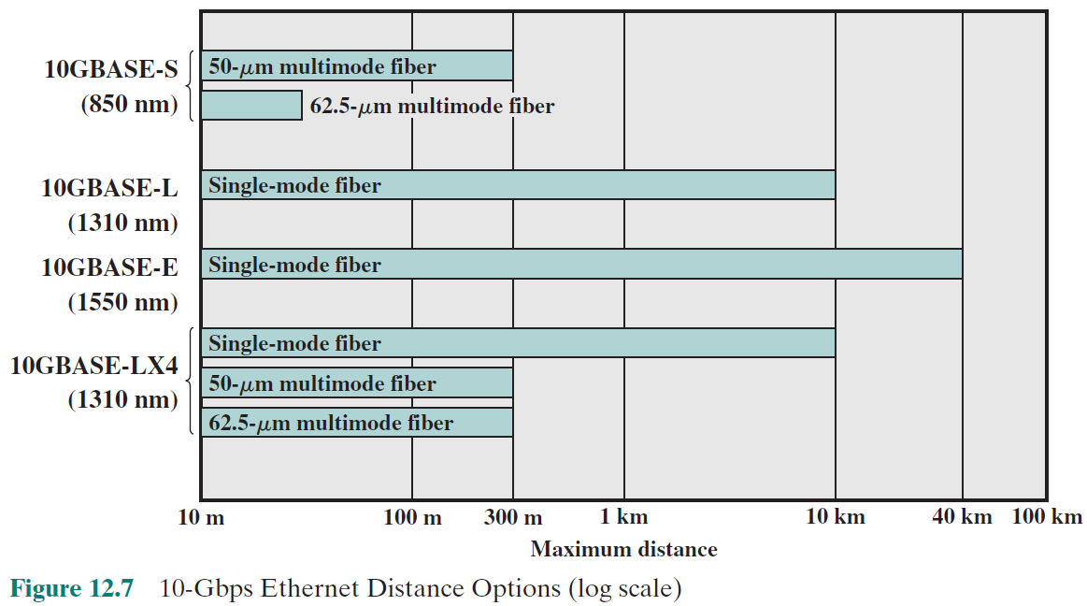

Slide 16
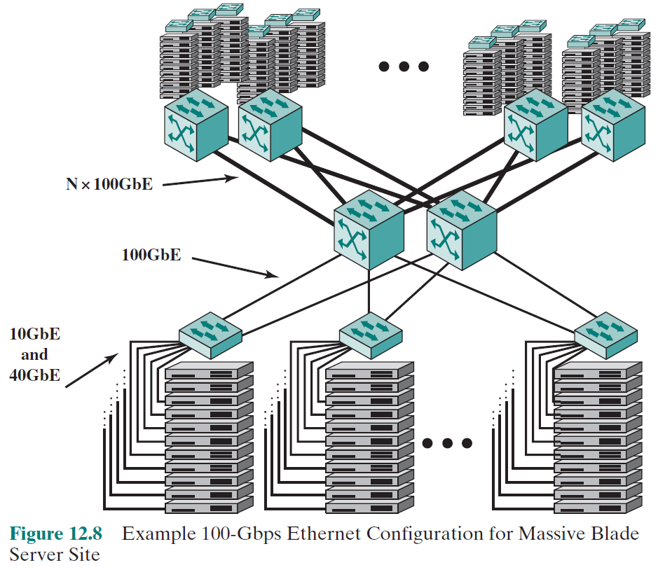
100 GB Ethernet

Slide 17
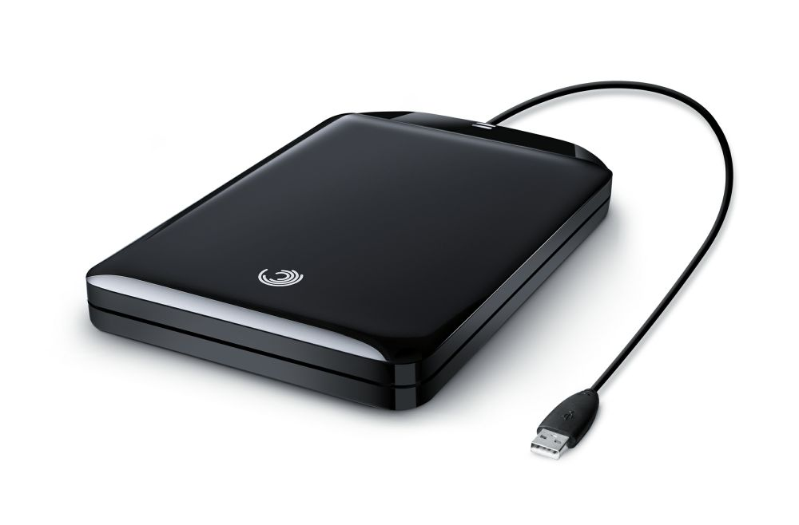
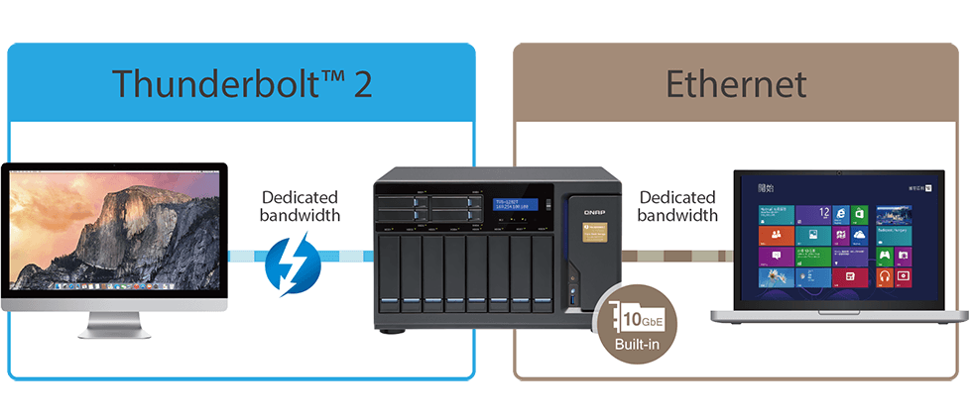
เมื่อปริมาณข้อมูลมากขึ้น สายสัญญาณก็ต้องรับ data rate ได้มากขึ้น
USB 3.0 5 Gb/s USB 3.1 10 Gb/s
20 Gb/s
10 Gb/s

