Slide 2
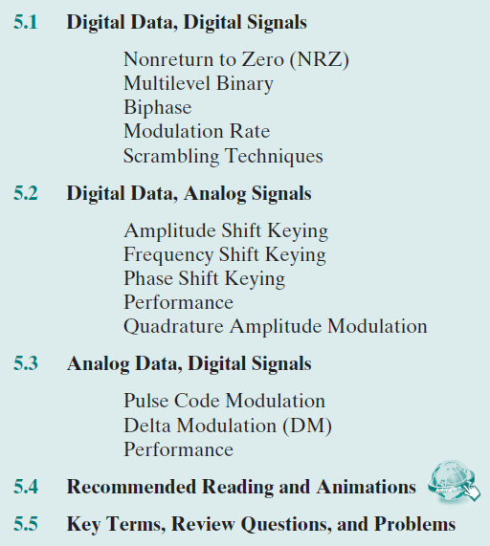

Slide 3
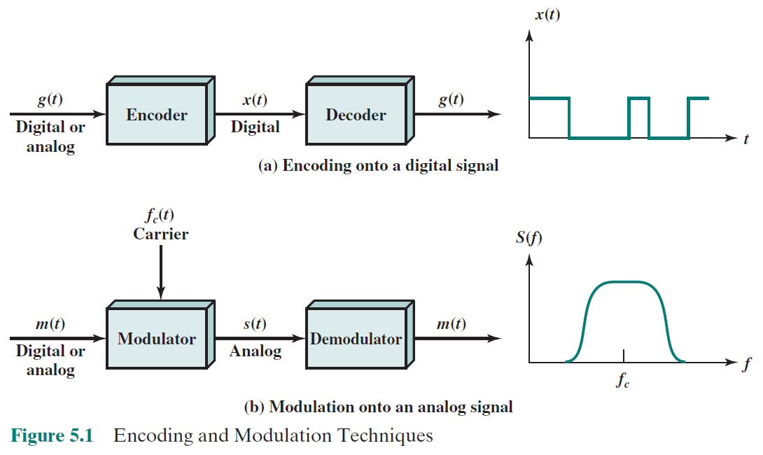
Bandlimited (bandpass) signal
Bandlimited (bandpass) signal

Slide 4
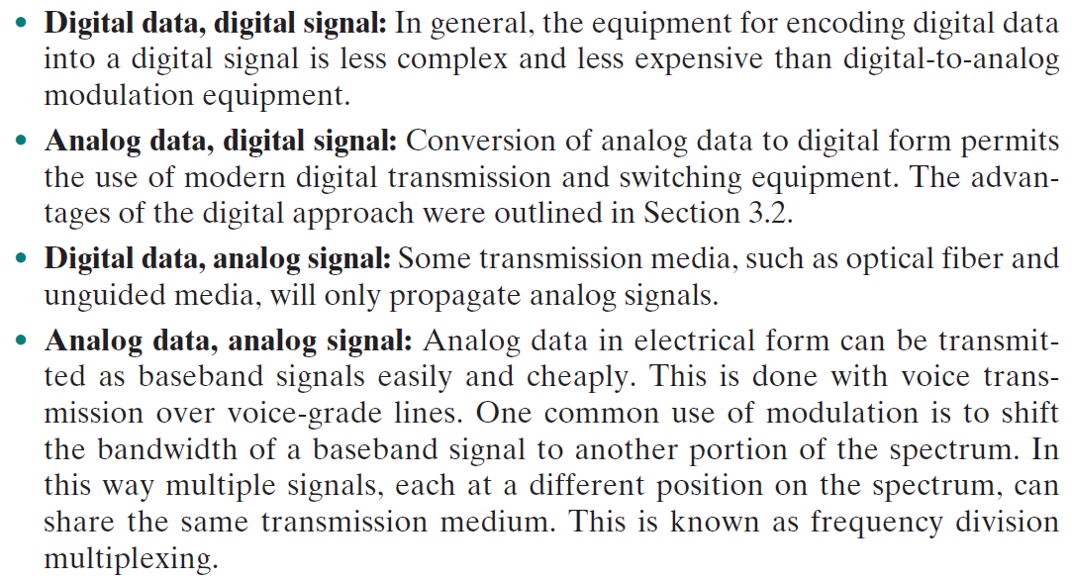

Slide 6
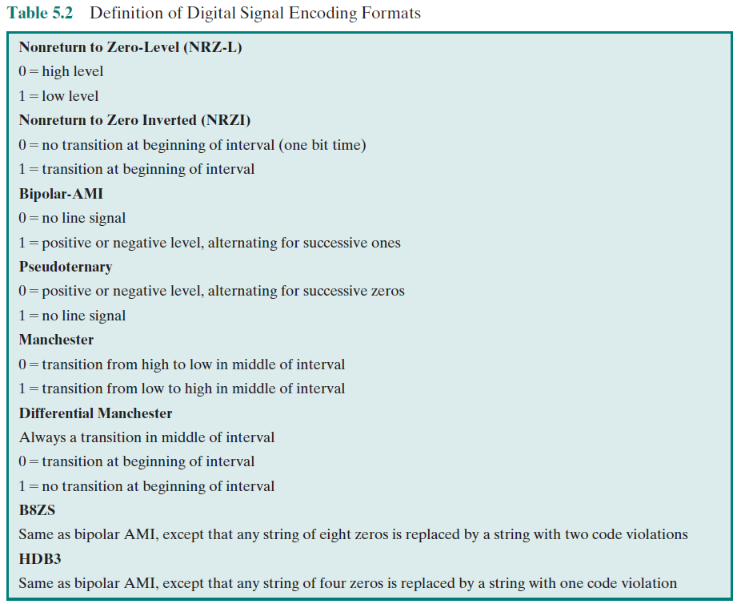

Slide 7
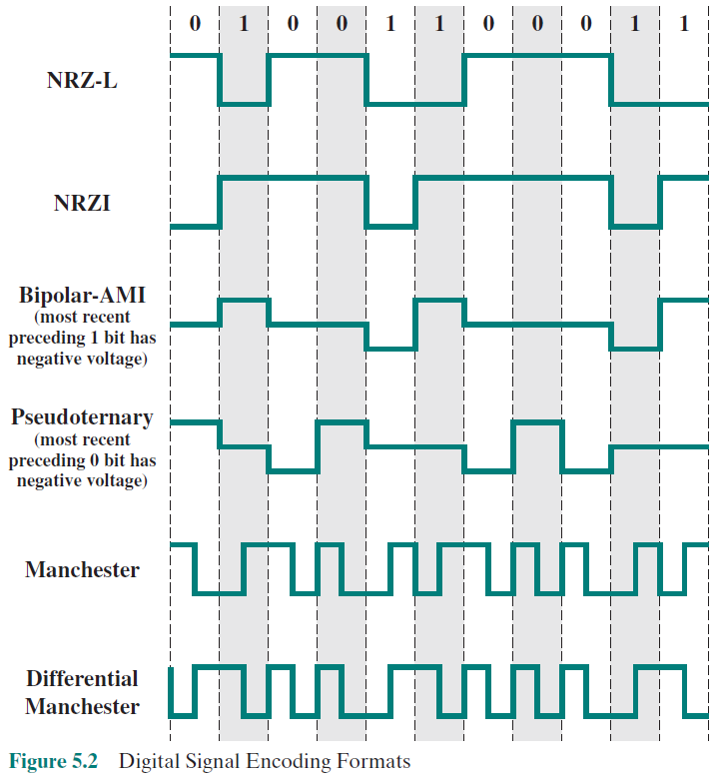
Digital to Digital
Constant positive voltage
Absence of voltage
Transition (positive/negative edges แทน 1)
No line signal = 0
Positive and negative pulses alternating in polarity = 1
No line signal = 1 (สลับกันกับ Bipolar-AMI)
Positive and negative pulses alternating in polarity = 0
Low-to-high transition = 1
High-to-low transition = 0
Transition at the beginning = 0
No transition = 1
บังคับให้เกิด transition ตรงกลางบิตด้วย เพื่อ synchronization

Slide 8
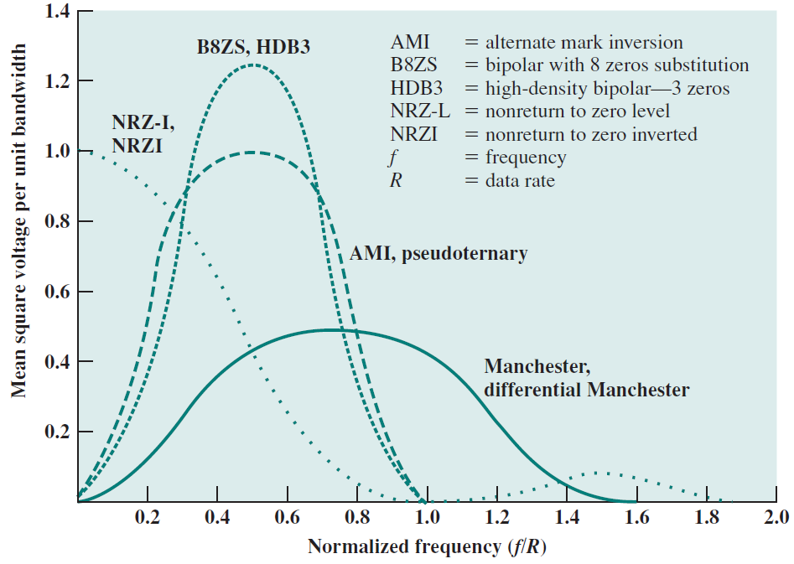
L
energy
bandwidth

Slide 9
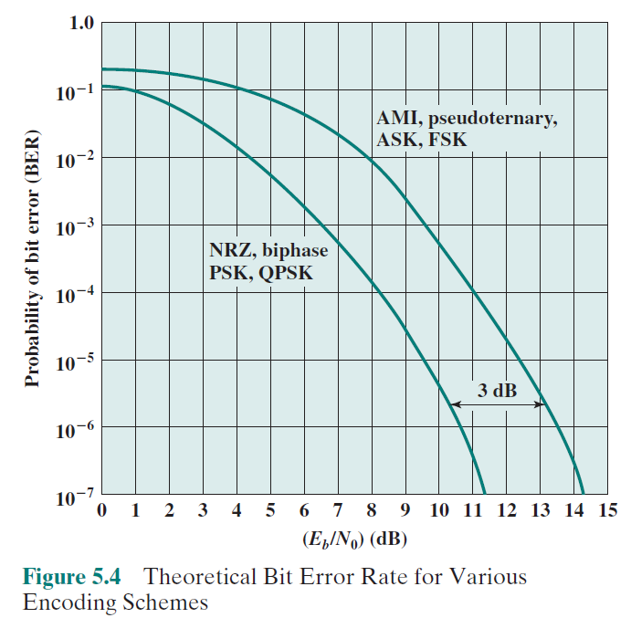

Slide 10
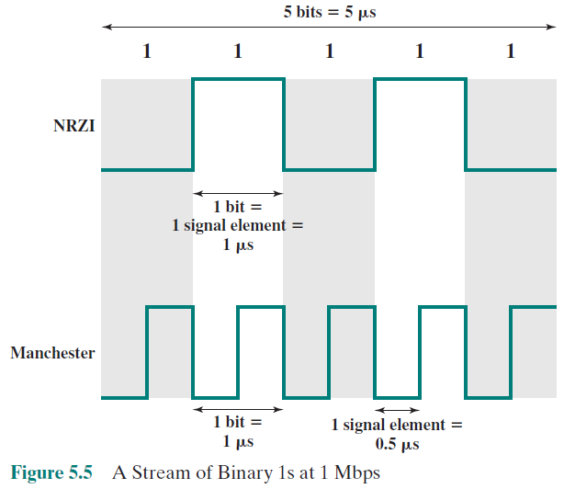
Modulation Rate

Slide 11
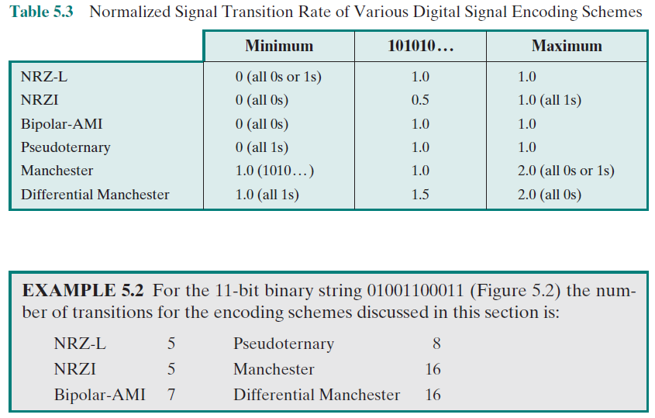
USB ใช้ encoding แบบไหน ?

Slide 12
Scrambling Techniques

Slide 13
Bipolar with 8-zeros substitution (B8ZS)
North America

Slide 14
High-density bipolar-3 zeros (HDB3)
Europe and Japan
Every string with four zeros is replaced by

Slide 15
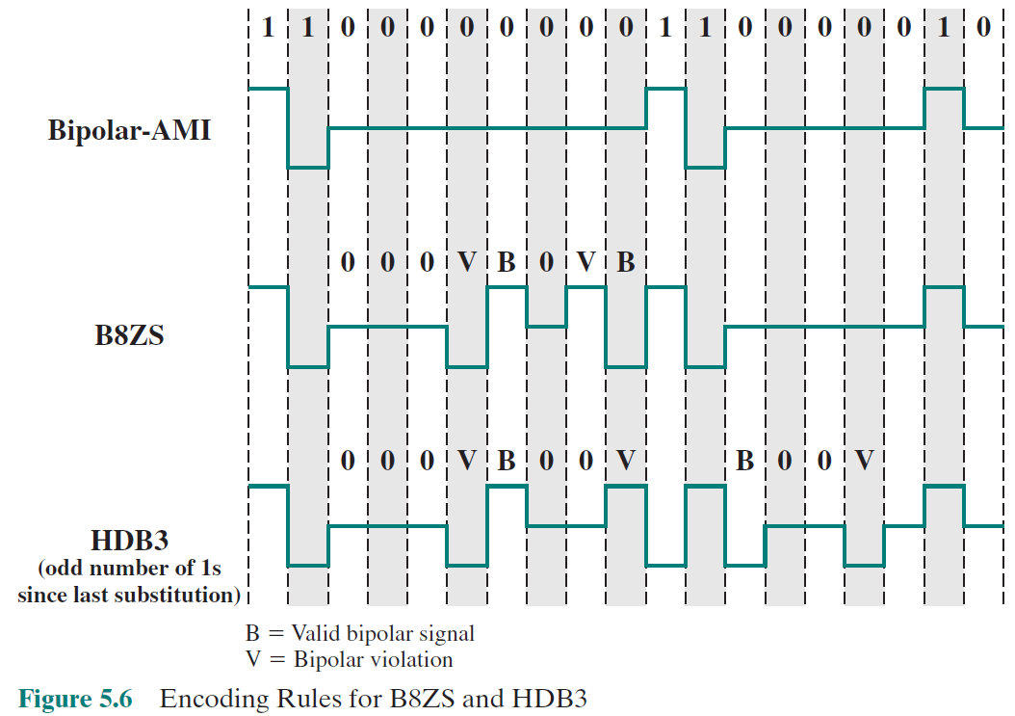
+
+
-
-
0
0
0
-
Assume

Slide 16
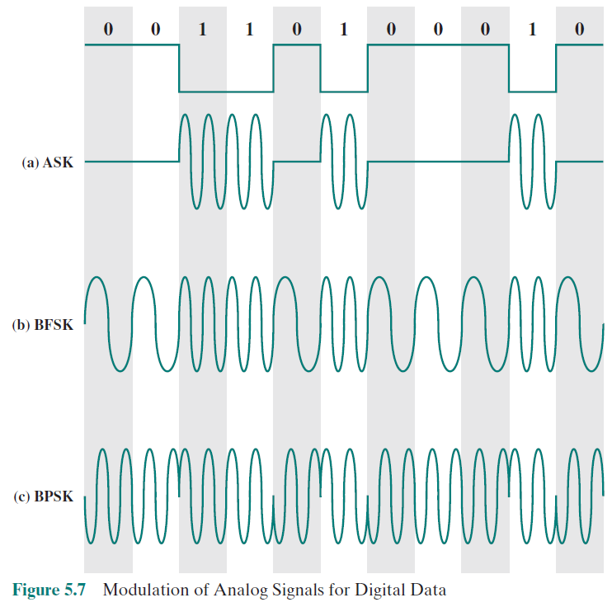
Digital to Analog
Amplitude Shift Keying
Frequency Shift Keying
Phase Shift Keying

Slide 17
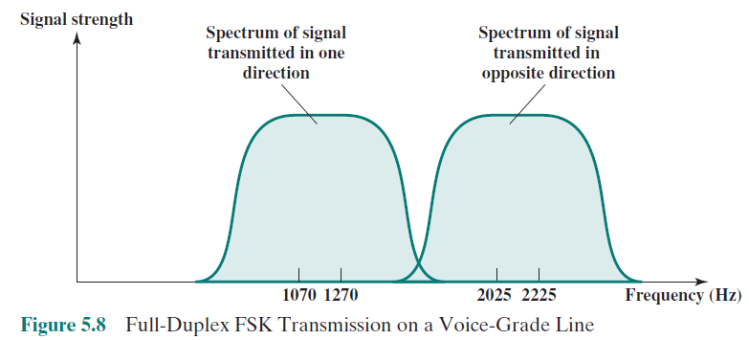

Slide 19
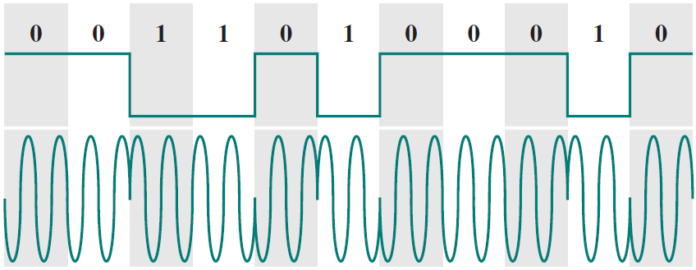
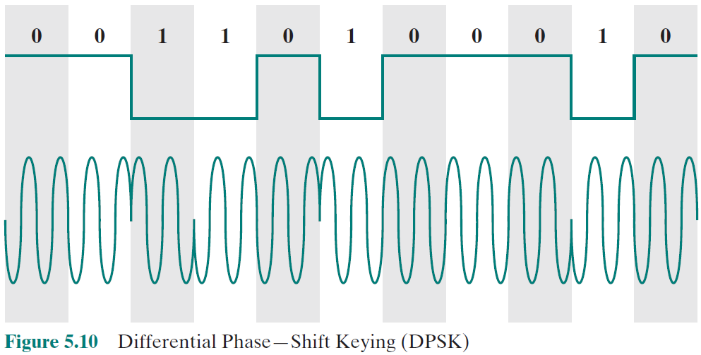
Binary PSK (BPSK)
First phase = 0
Second phase = 1
Differential PSK (DPSK)
Same phase = 0
Shift phase = 1

Slide 20
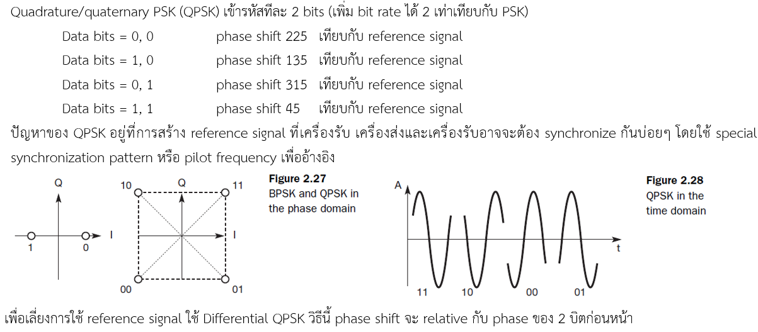
Quadrature Phase Shift Keying (QPSK)

Slide 21
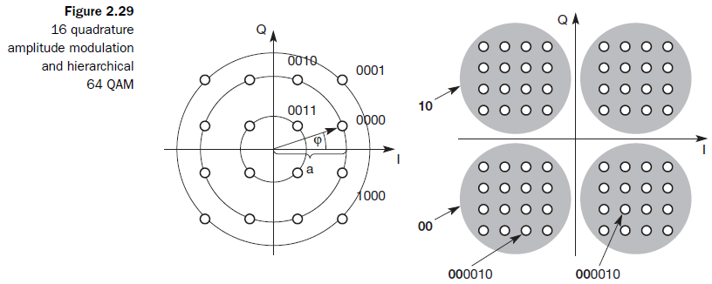
Quadrature Amplitude Modulation (QAM)

Slide 22
Analog to Digital

Slide 23
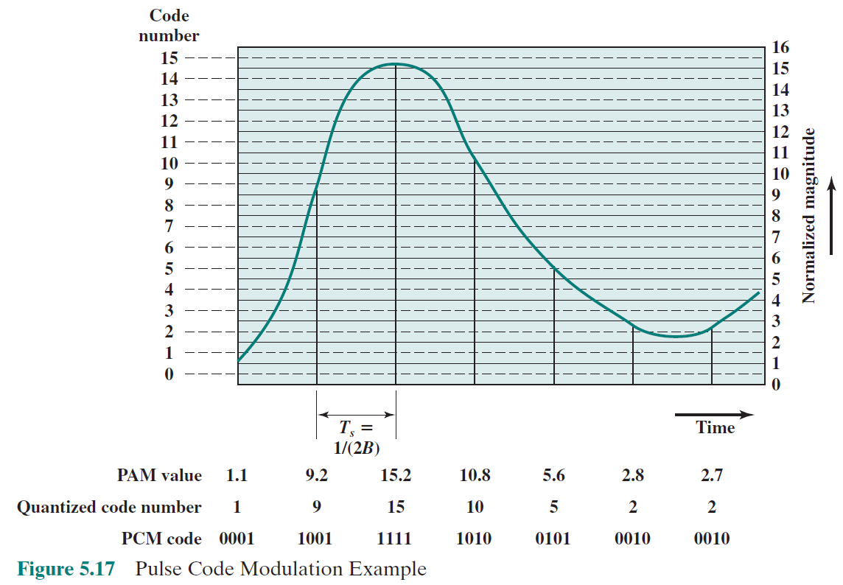

Slide 24
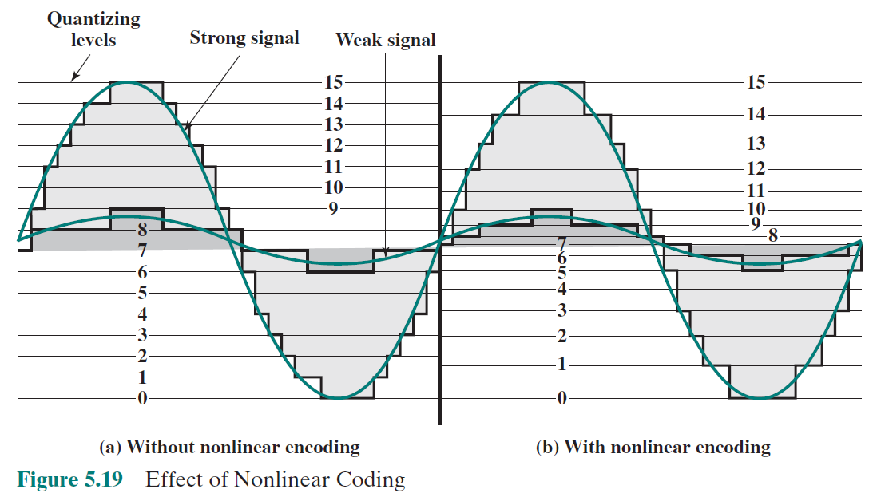

Slide 25
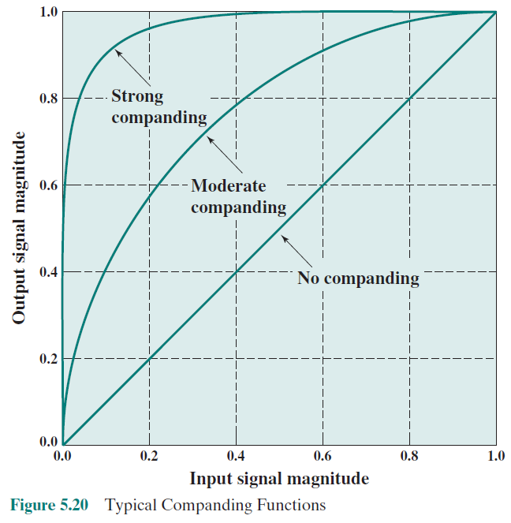
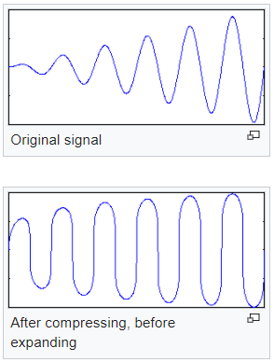

Slide 26
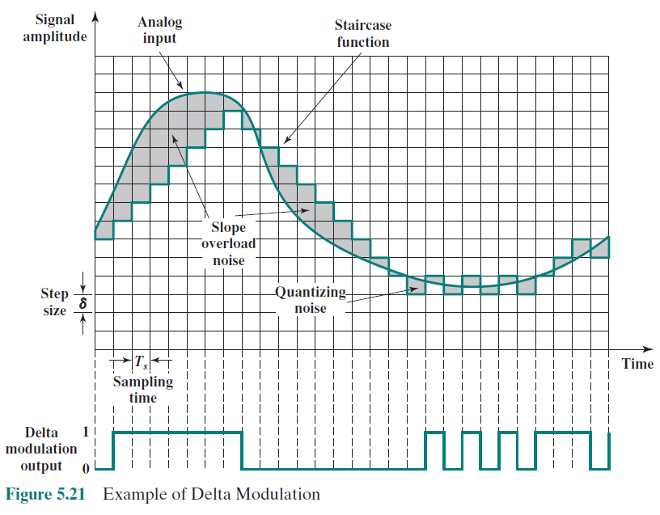

Slide 27
