Slide 1
แก้ไขครั้งล่าสุดเมื่อวันที่ 25 กุมภาพันธ์ 2568
2301361 SYSTEMS ANALYSIS AND DESIGN

Slide 2
4
Understanding Processes with Use Cases and Process Models

Slide 3
If you cannot explain something in simple terms, you don't understand it. (Richard Feynman)

Slide 4
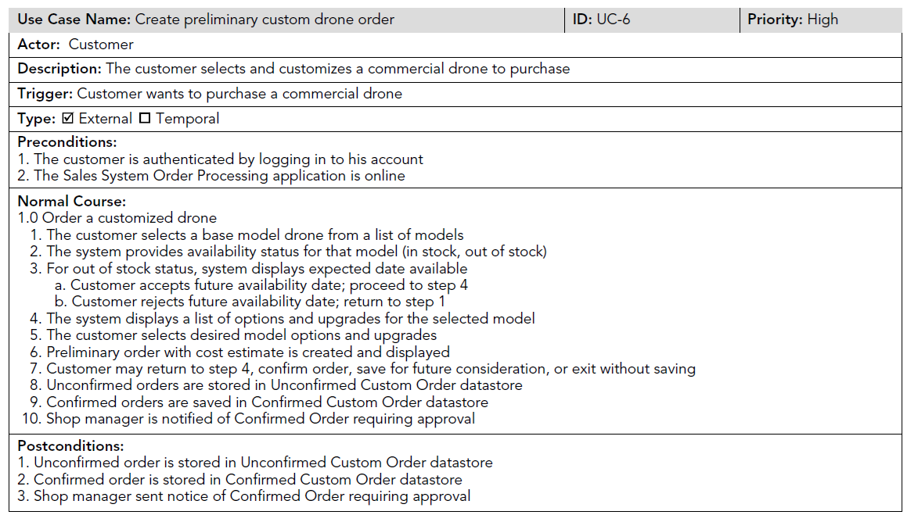
Use Case
A person, hardware, software, or user role
Happy path
ถ้าพัฒนาแบบ Agile ไม่ต้องทำเอกสารนี้ละเอียดมาก เพราะ user representatives อยู่กับทีมพัฒนาตลอดเวลา แต่ในบางครั้ง user representatives ก็ไม่ได้อยู่ด้วย

Slide 5
Figure 4-1 is unwieldy.

Slide 6
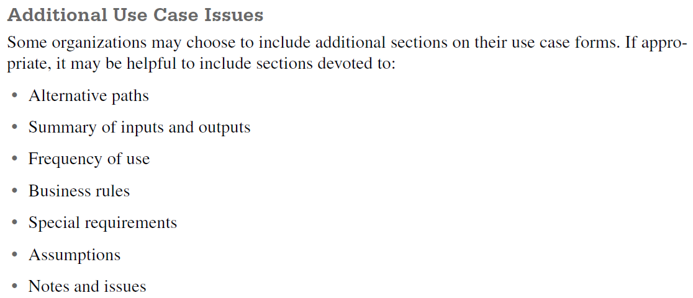

Slide 7
ข้อคิดในการทำ Use Cases
Use cases depict user–system interactions as abstract, technology-independent steps.
You should not expect to create a perfect use case on the first try. The process of building use cases is one of gradual refinement: As users and analysts work through the parts of the use case, they often return to previous parts to correct them.
On the team, there should be at least one person who has a programming perspective to ensure adequate precision and accuracy in the use case; another person who has deep knowledge of the business rules that the system must enforce; and another person who is thoroughly familiar with how the system will actually be used.
It is tempting for novice analysts, however, to incorrectly assume that the use case is all that is needed to fully define what the system must do.
By studying the use cases and the functional requirements derived from them, the testing personnel can readily identify elements of the tests they will want to perform when the system enters testing.

Slide 9
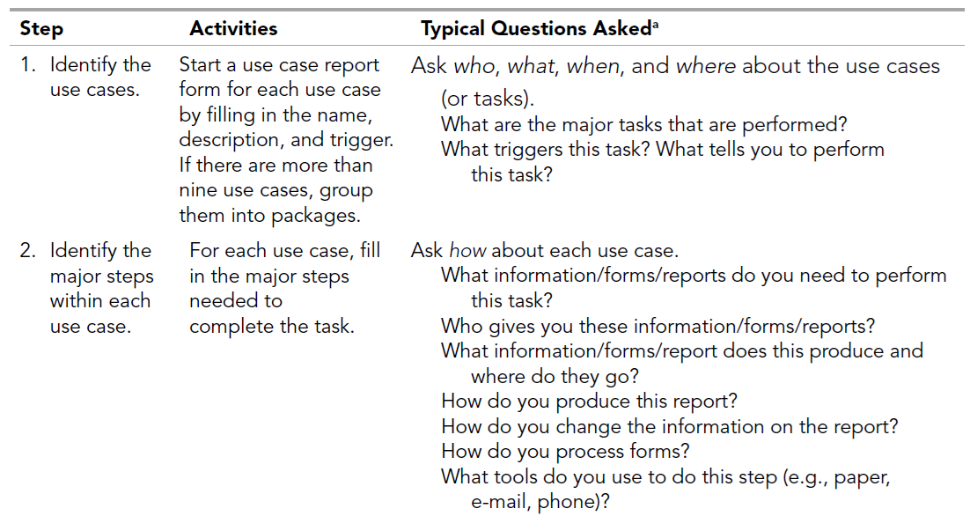
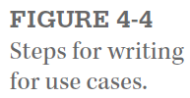

Slide 10
บทบาทสมมติ

Slide 11
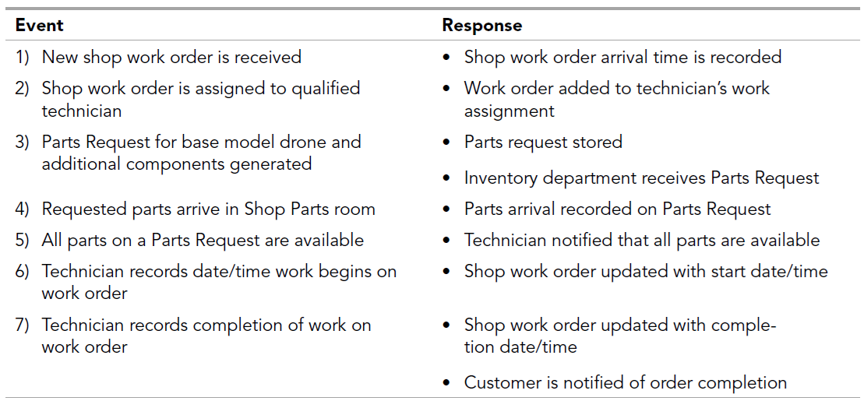
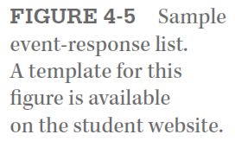
In this example, we focus on the Drone Customization Shop Management.
these events are three parts of the overall user goal of obtaining all needed components for a drone customization work order.

Slide 12
3
4
5
If the project team discovers more than eight or nine major use cases, this suggests that the system is complex (or that the use cases are not defined at the right level of detail). If there really are more than eight or nine major use cases, the use cases are grouped together into use case packages.
ใน data flow diagram น่าจะยุบเป็น process ใหญ่ชื่อ Obtain all needed components (for a drone customization work order)
แล้วแตกเป็น process ย่อย 3 processes
Create parts request
Record receipt of component
Finalize parts request

Slide 13
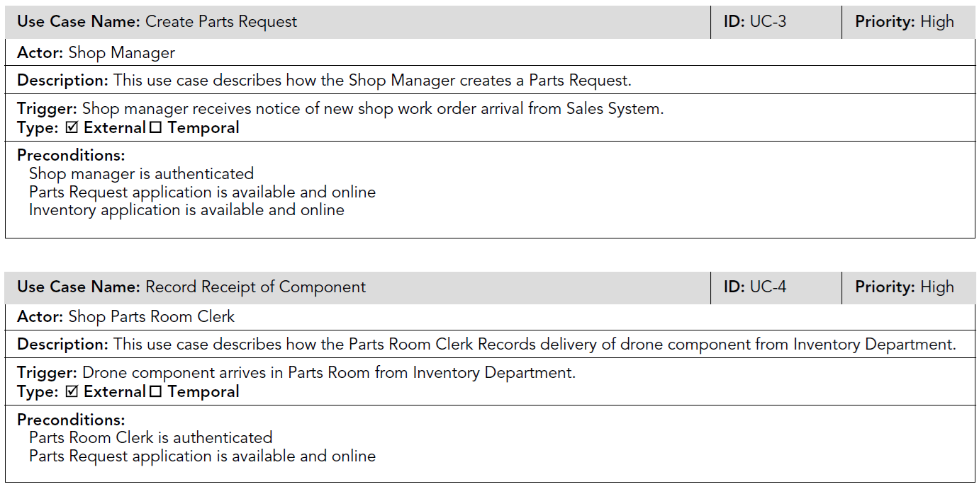
Major use cases with basic information

Slide 14
If you end up with more than nine steps or steps that vary greatly in size, you must go back and adjust the steps. Recognizing the size of the steps takes practice but will become natural in time.

Slide 15
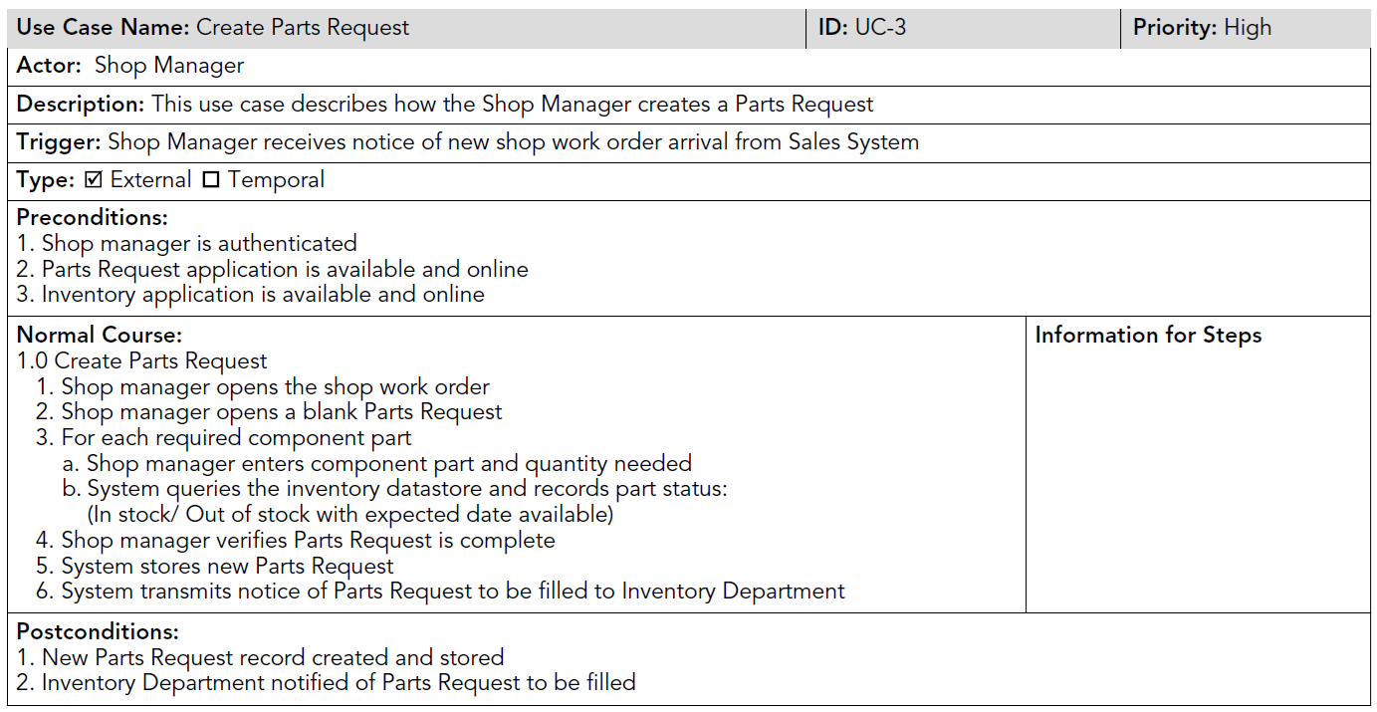
After several revisions, the team settled on the partial use cases shown in Figure 4-8.

Slide 16
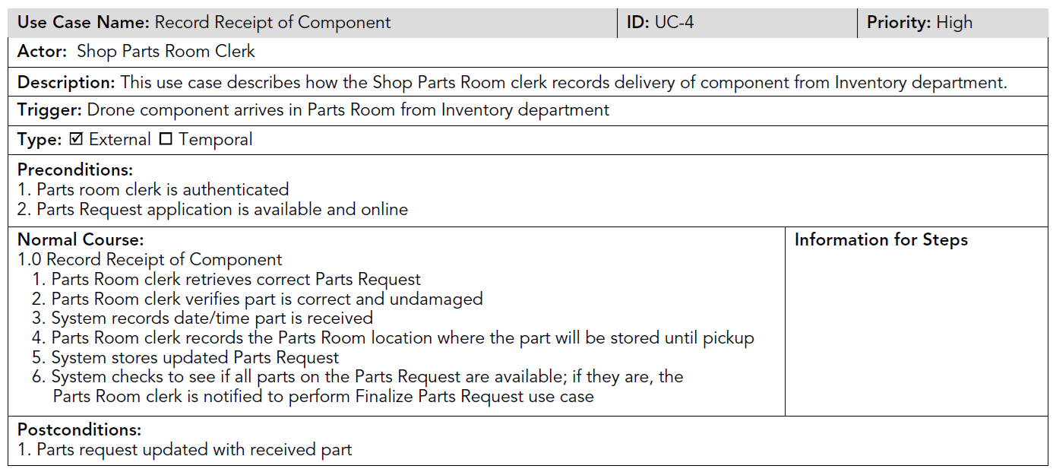

Slide 17
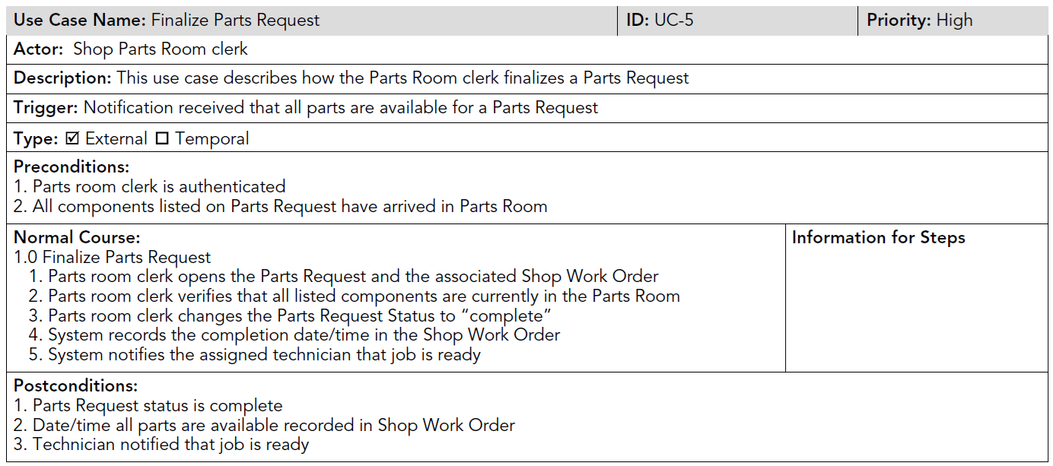
The use case forms in Figure 4-8 require some final work before they are complete. The last column (“Information for Steps”) must be completed, and arrows may be drawn to describe inputs and outputs from the steps.

Slide 18
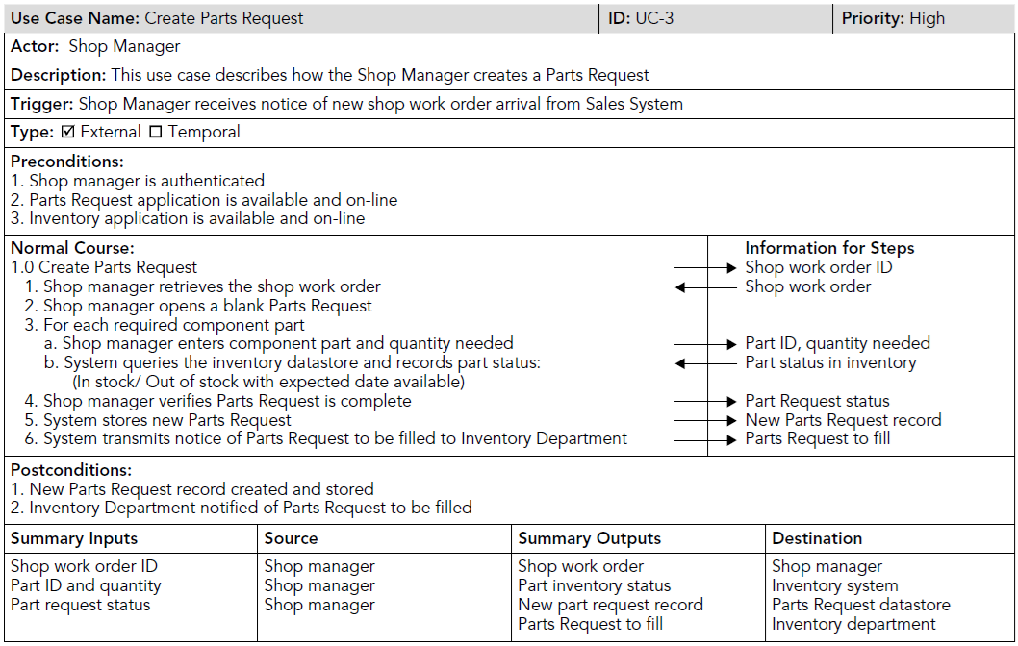
1
1

Slide 19
Process
Shop manager
Shop work order ID
Shop work order
Process
Shop manager
Part ID and quantity
Part inventory status
Inventory system
Process
Parts Request to fill
Inventory department
Shop manager
Part request status
New part request record
Parts Request datastore

Slide 20
The Summary area for inputs and outputs found at the end of the use case form is completed once the team is satisfied with the steps, inflows, and outflows listed previously. In this section, all the input flows are listed in the left-most column and their source is specified in the adjacent column. In the third column, all the output flows are listed, and their destination is specified in the right-most column. As we have mentioned, this summary area allows the team to easily view all the inputs that must be included to complete the use case and all the outputs that will be produced by the use case. This area of the use case form will be especially useful if the team decides to depict the system with data flow diagrams.
เลือกใช้ diagram อื่น ๆ ที่เหมาะสมกับระบบ Data Flow Diagram (DFD) เหมาะกับงานภายในองค์กร (ธุรกิจเอกชน/ราชการ) แต่ไม่เหมาะกับวีดีโอเกม เกมออนไลน์ ฯลฯ

Slide 21
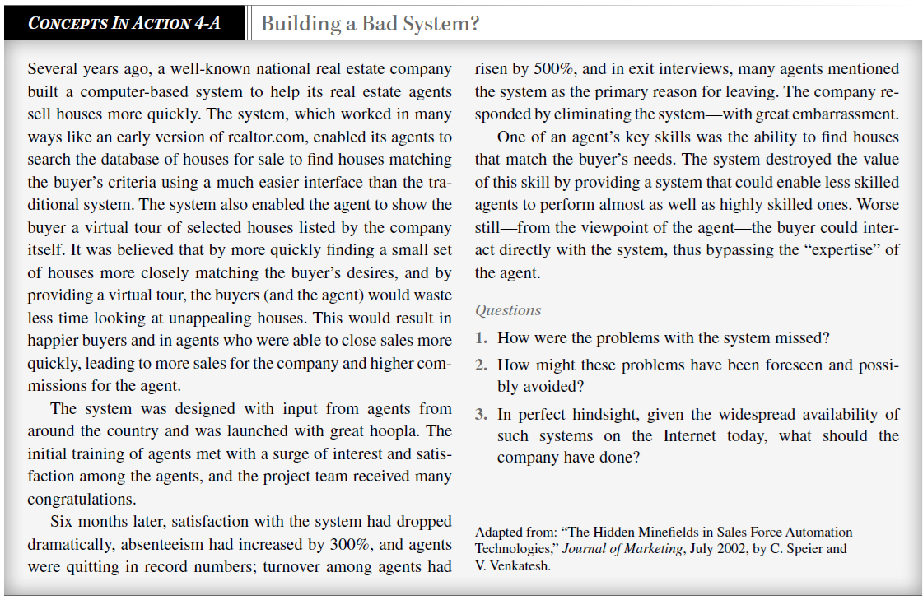

Slide 22
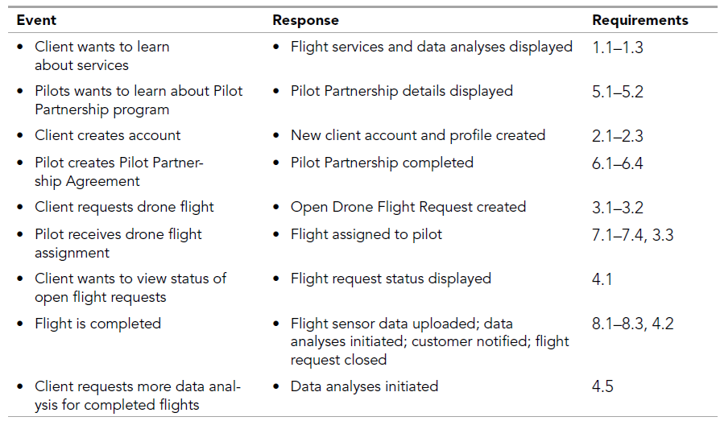
ทำ Use Cases ที่เหลือให้ครบ

Slide 23
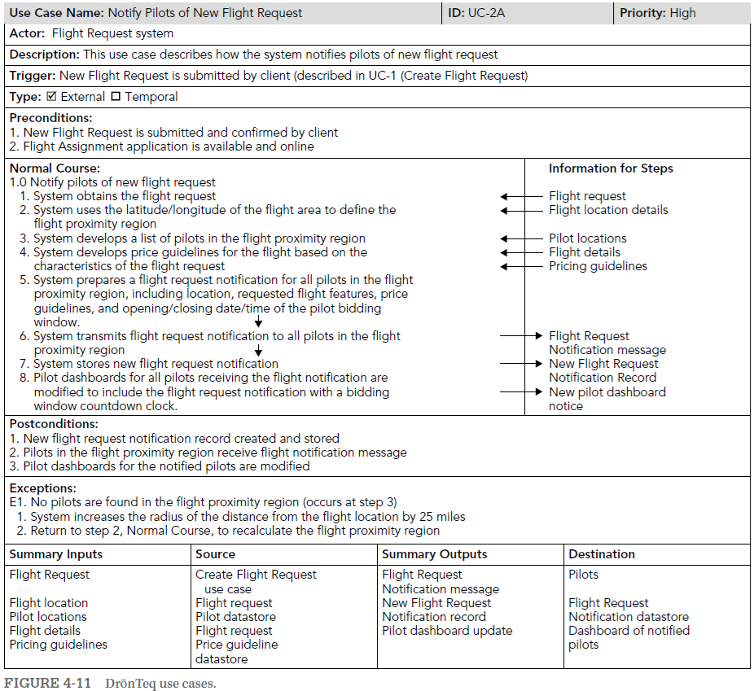

Slide 24
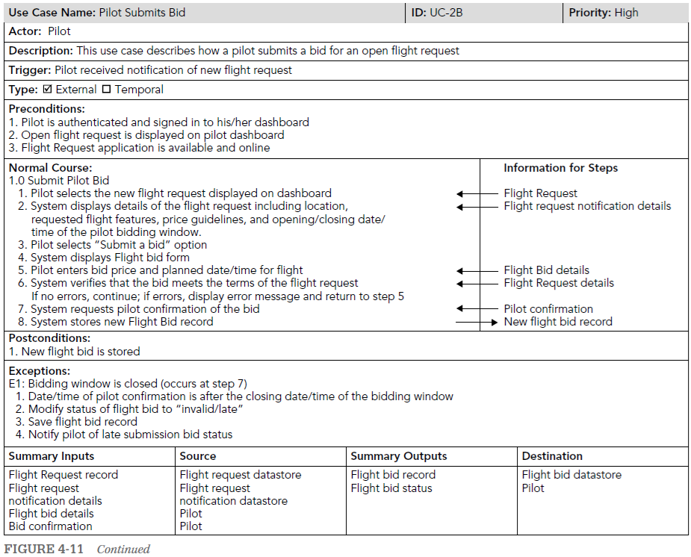

Slide 25
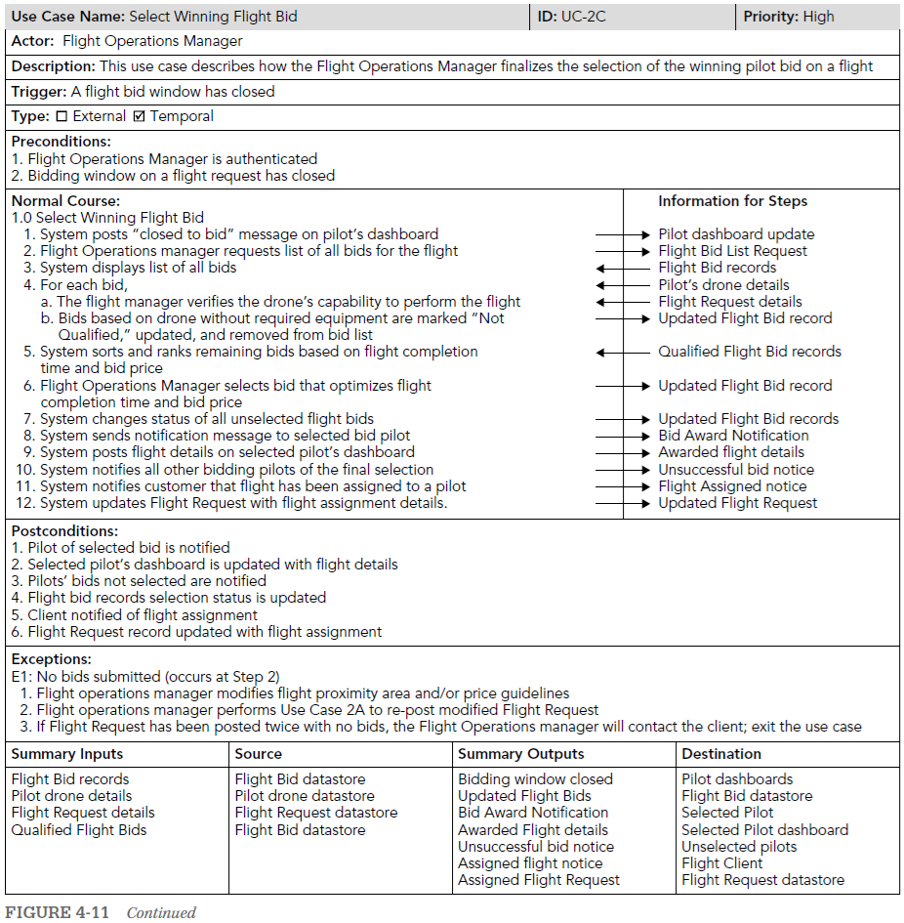

Slide 26
Data Flow Diagrams (DFDs)

Slide 27
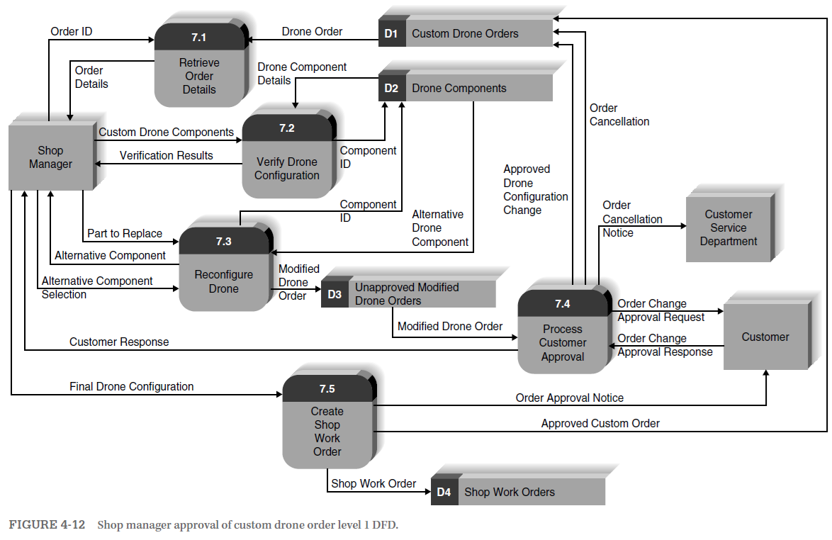
นิยมลากเส้นตรงหรือเส้นฉากเท่านั้น ไม่ลากเส้นโค้ง

Slide 28
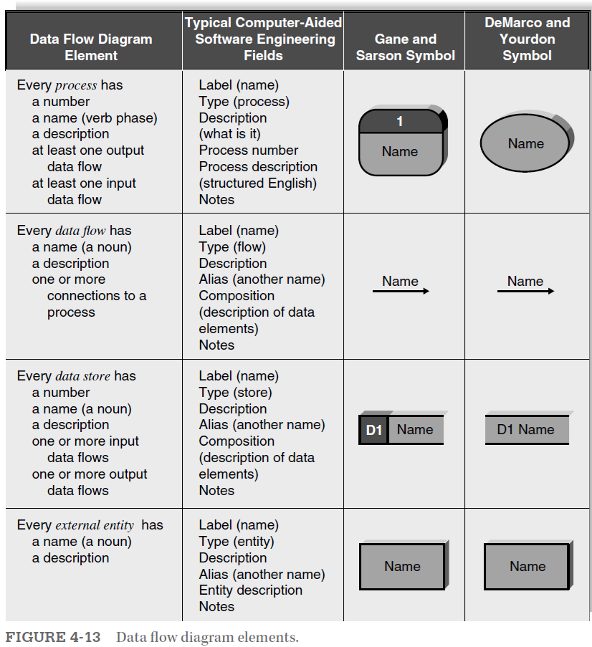
A process is an activity or a function that is performed for some specific business reason. Processes can be manual or computerized.
A data flow is a single fact, such as Order ID (sometimes called a data element), or a logical collection of several facts (e.g., new shop work order). Every data flow should be named with a
noun.
A data store is a collection of data that is stored in some way (which is determined later when creating the physical model). Every data store is named with a noun and is assigned an identifi-cation number and a description.
An external entity is a person, organization, organization unit, or system that is external to the system, but interacts with it (e.g., customer, clearinghouse, government organization, accou-nting system).

Slide 29
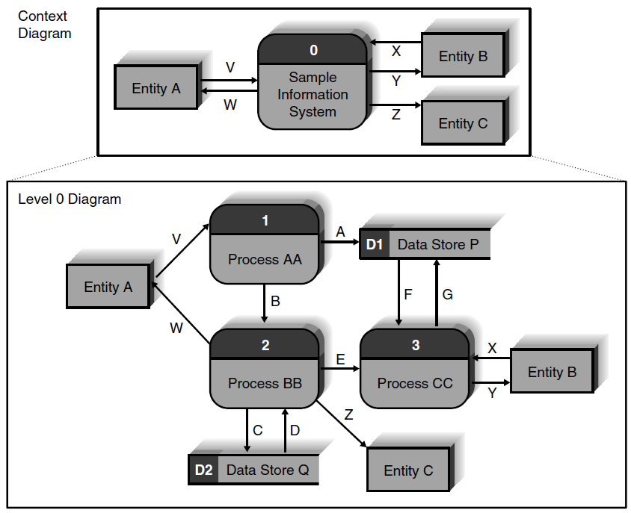
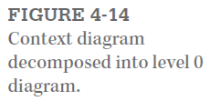
ไม่ต้อง เขียน 0 ก็ได้
ปกติผมทำ level 0 ก่อน
แล้วค่อยทำ level 1, 2, 3, …
context diagram ไว้ทำทีหลังสุด
แยกเขียนเป็นหลาย ๆ หน้าได้
0 คือยังไม่แบ่งเป็น process ย่อย

Slide 30
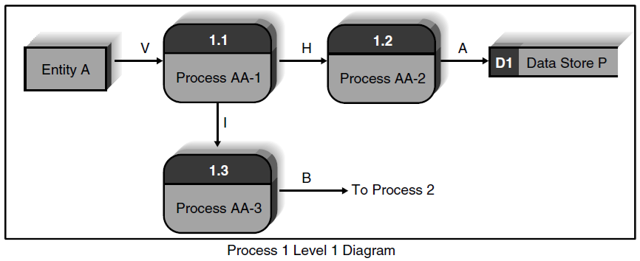
Level 1 คือแบ่ง 1 ครั้ง ทศนิยม 1 ตำแหน่ง
นิสิตมักจะทำผิด คือพยายาม flow data จาก process แรกไปจนถึง process สุดท้าย หรือให้มีเส้นเชื่อมทุก process เข้าด้วยกัน วิธีที่ถูกคือ process แรกอาจจะรับข้อมูลจากผู้ใช้ แล้วบันทึกลง data store จากนั้น process ต่อ ๆ ไป ก็อ่านจาก data store

Slide 31
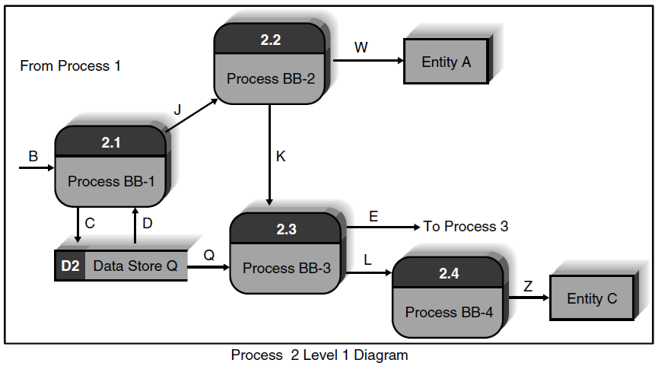

Slide 32
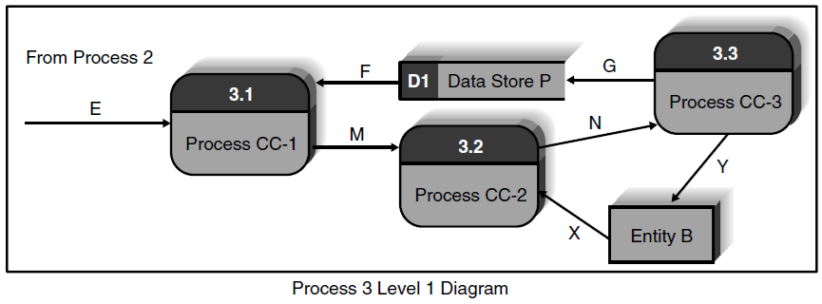

Slide 33
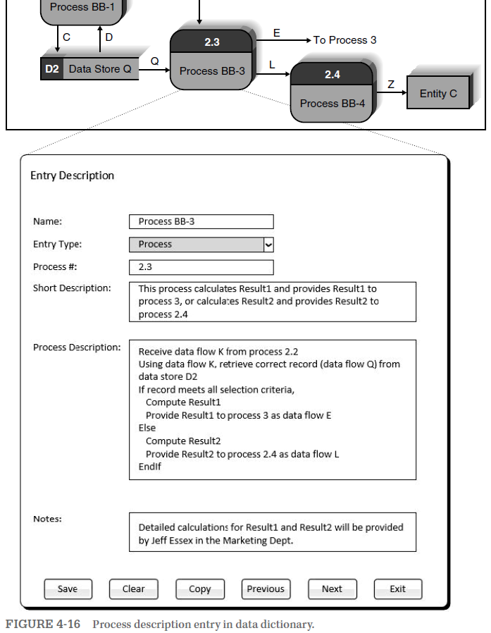

Slide 34
1.1.1.1.1.1.1
หาคนตรวจรับงานยาก ต้องใช้นักวิชาการคอมพิวเตอร์

Slide 35
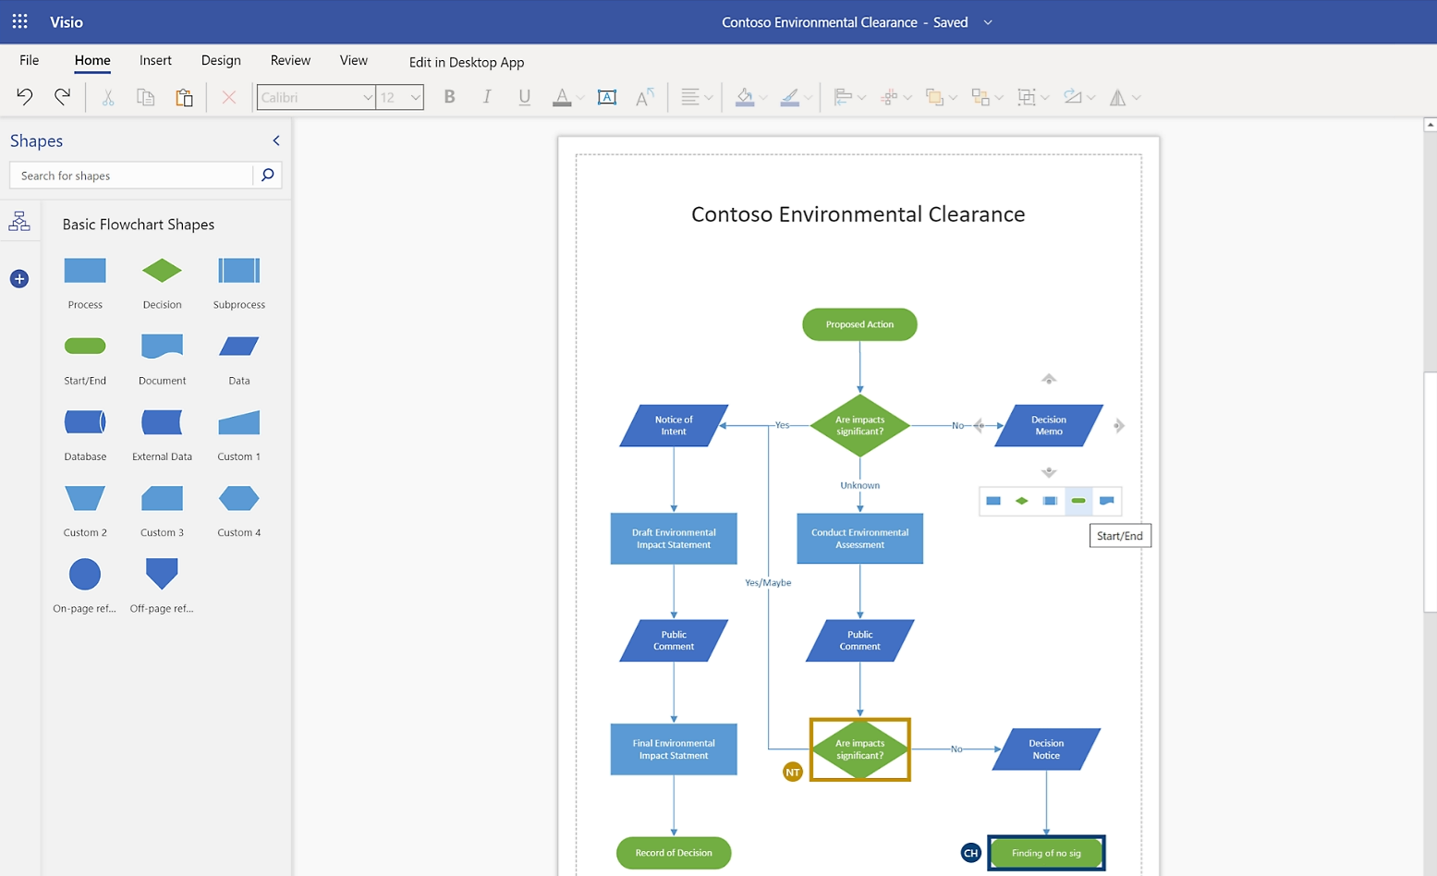

Slide 36
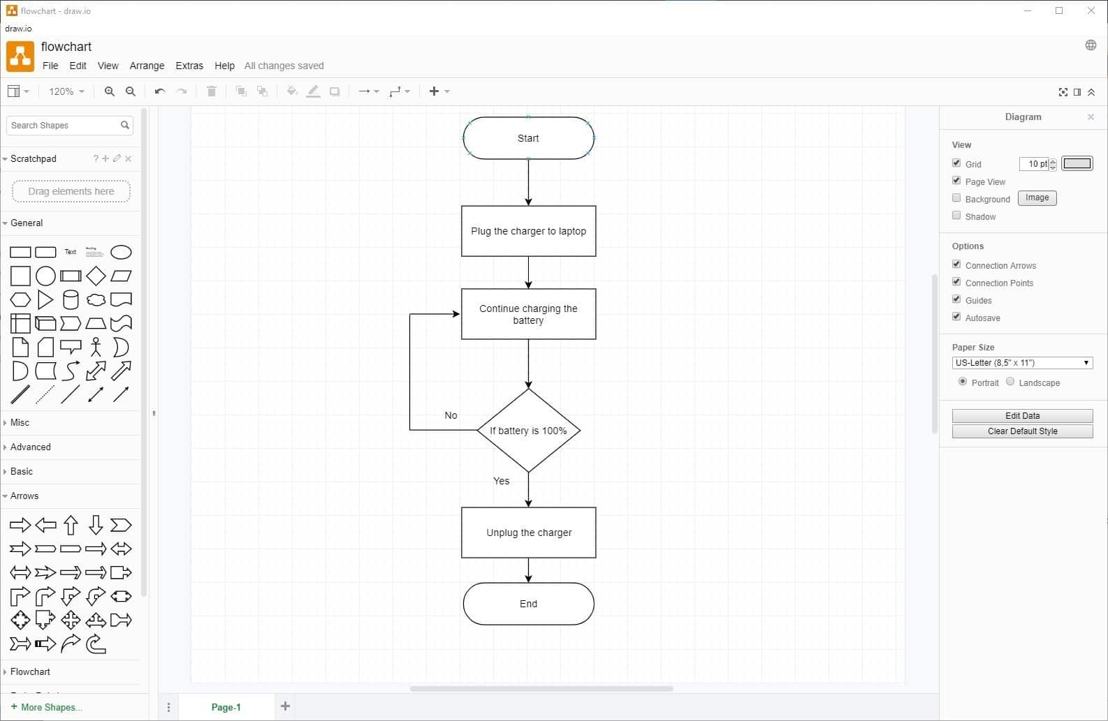

Slide 37
